Slide 1
Electronics for physicists
Chapter 3

Slide 2
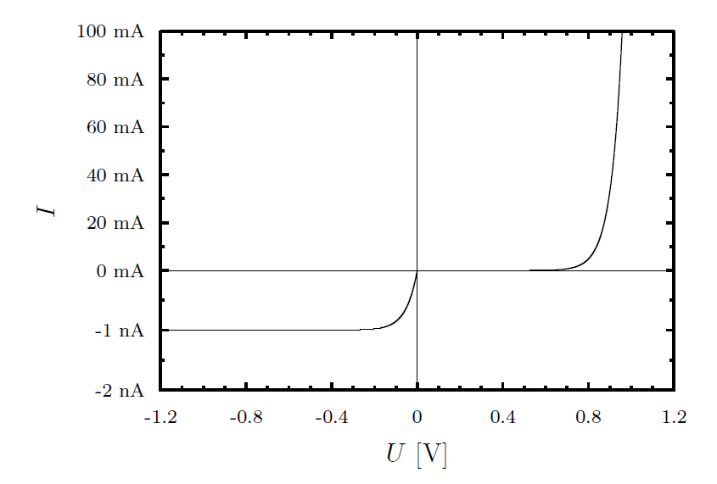
Diode
Circuit symbol
backward
bias
forward
bias
Passive
Non-linear
Two connections
High forward current flow. Minimum leakage current at reverse bias.
At ≈ 1/10 of maximum current:

Slide 3
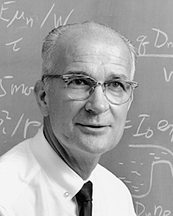
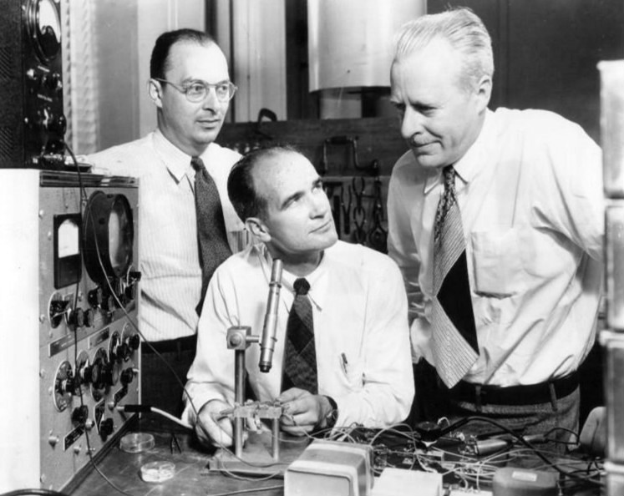
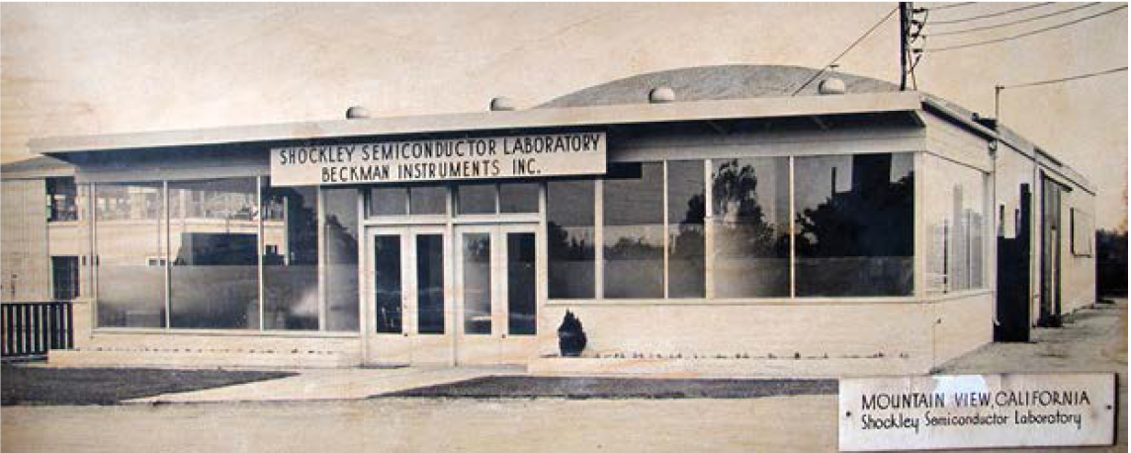
William B. Shockley
Physicist and engineer
Nobel prize for discovery of transistor
Pioneer of electrical engineering
One of the „founders“ of Silicon Valley

Slide 4
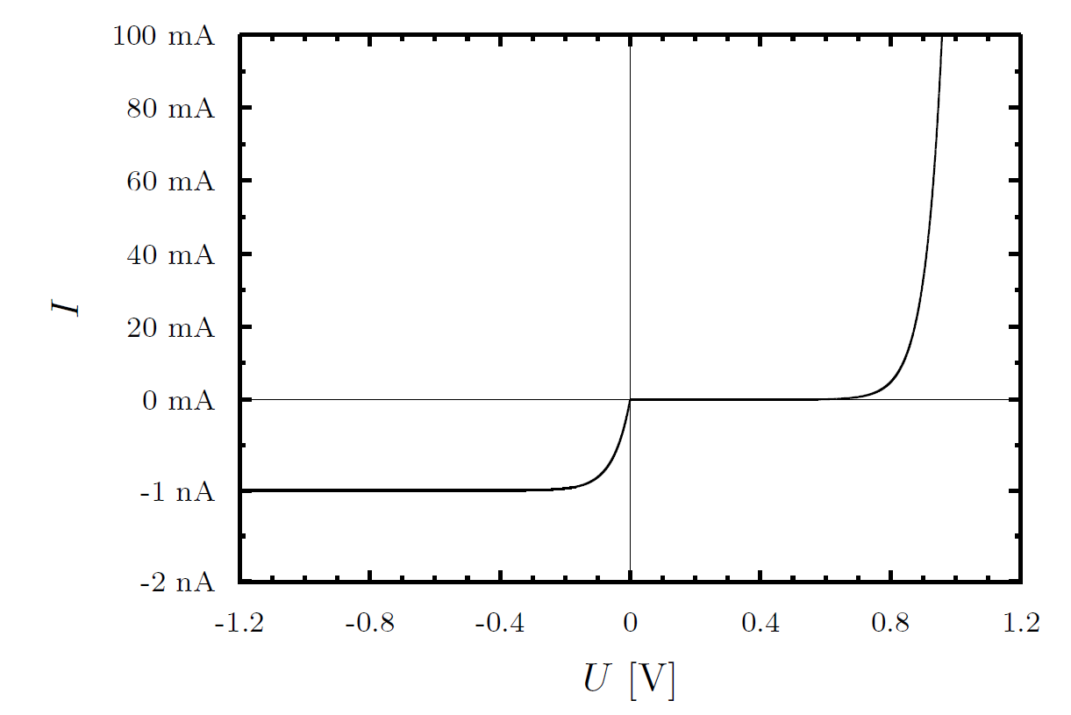
Diode characteristics
Reverse bias
Forward
bias
Shockley equation:
with U_{T} ≈ 26 mV at 300 K

Slide 5
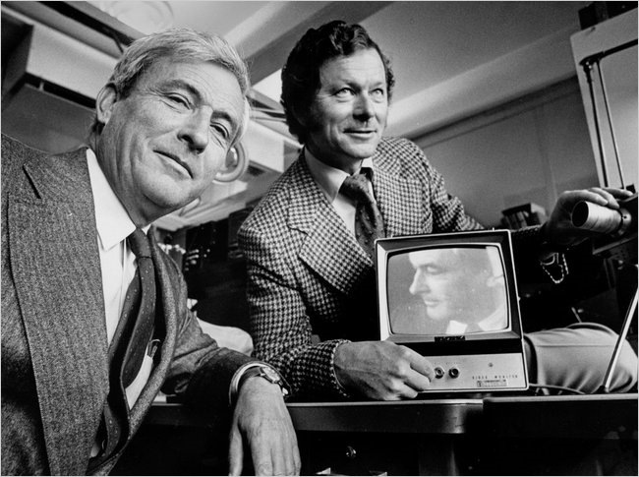
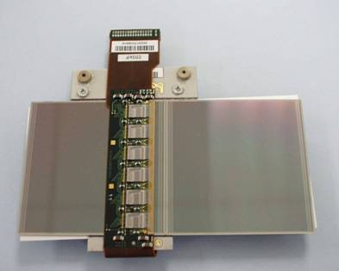
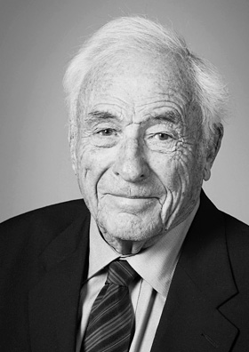
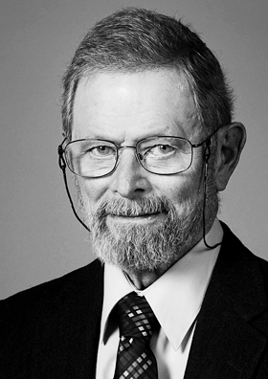
Detector diode examples
CCD camera (Nobel prize 2009)
ATLAS Semiconductor Detector
768 diodes
80 μm
Willard S. Boyle
George E. Smith

Slide 6
In reality diodes are complex
→
n = 1
Ge diode
n = 2
Si diode

Slide 7
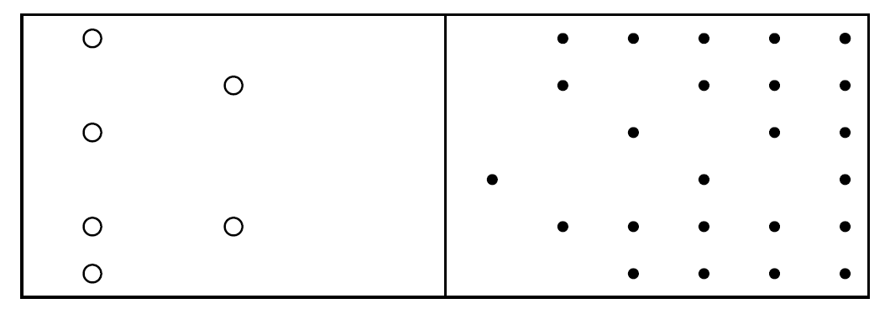
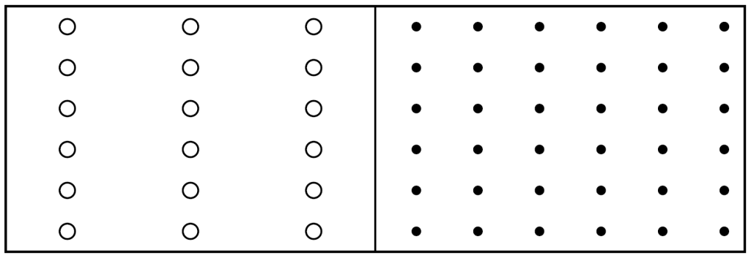
Diode
pn junction before diffusion of mobile carriers pn junction after diffusion
() holes
the p-doped side
(•) excess electrons
n-doped side
Depletion or space charge region

Slide 8
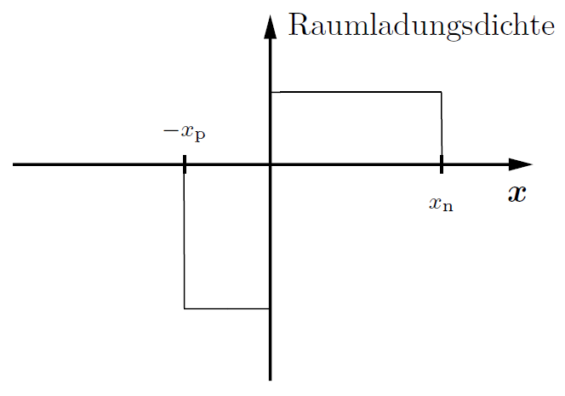
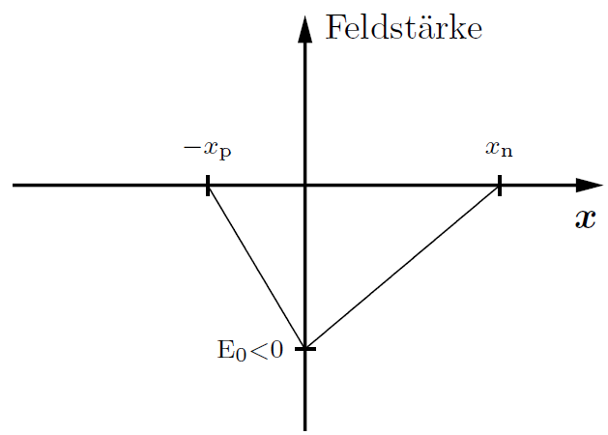
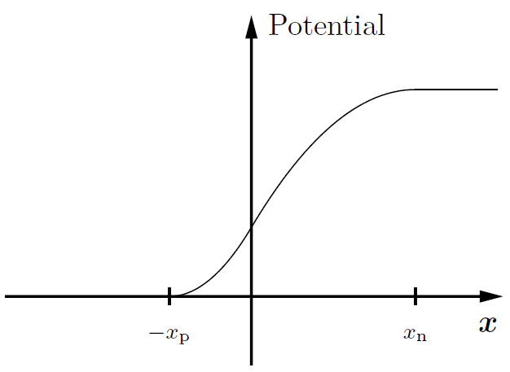
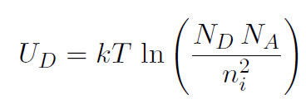
Fields accross a pn junction without external bias
Space charge density field strength potential across diode
Width of depletion region depends on doping levels and external bias voltage

Slide 9
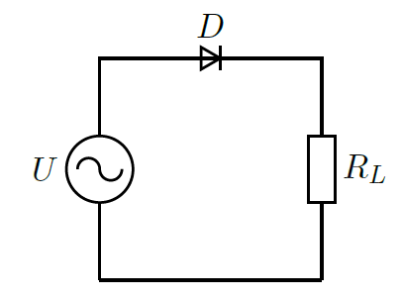
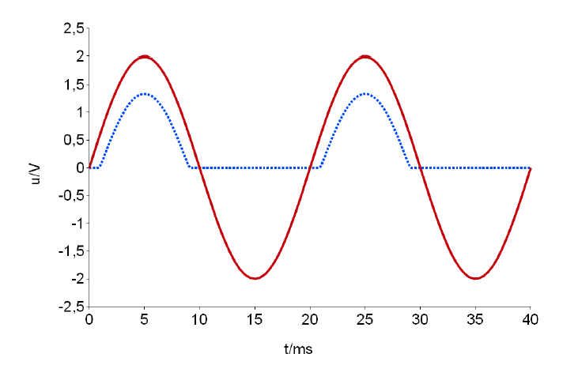
Rectifying circuit
U_{out}
diode drop
Input
Output
U [V]
ripple
t [ms]

Slide 10
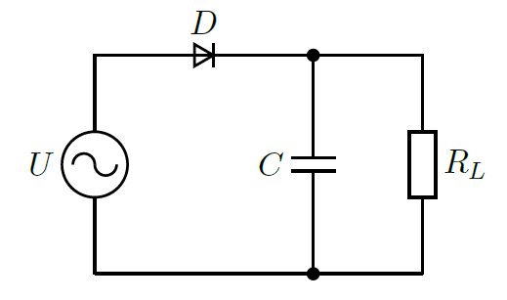
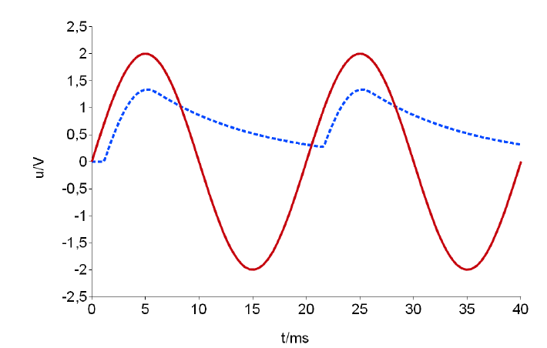
Improved rectifier
charge
discharge
Input
Output
U [V]
t [ms]
Ripple:

Slide 11
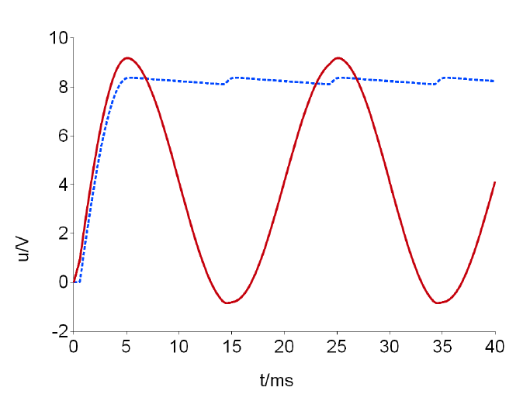
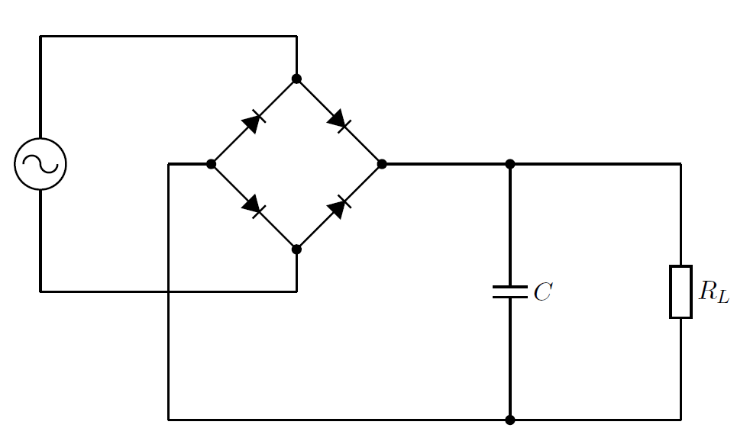
Graetz rectifier (full bridge)
U [V]
t[ms]
Less ripple. Energy transfer during both positive and negative cycle.

Slide 12
Grätz rectifier (full bridge)
+ 10 V
9,4 V
9,4 V
8,8 V
0 V
Efficiency < 8.8/10
= 88 %
0,6 V
-10 V
- 0,6 V
- 0,6 V
8,8 V
0 V
- 9,4 V

Slide 13
Grätz rectifier (full bridge)
8,8 V
0 V
8,8 V
0 V

Slide 14
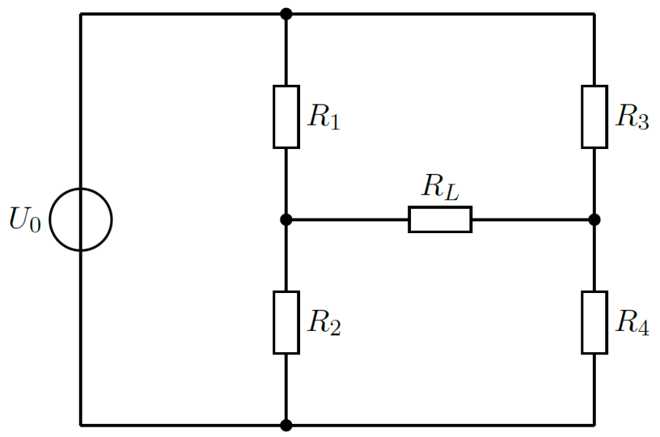
Full bridge

Slide 15
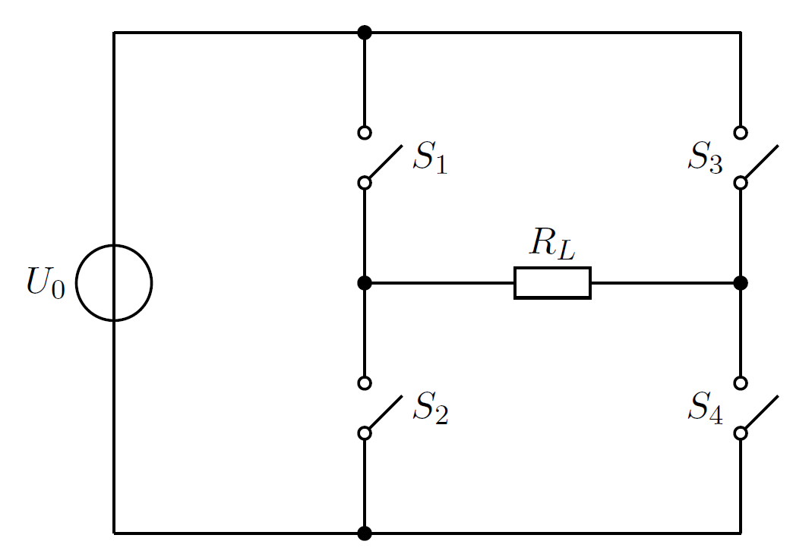

Slide 16
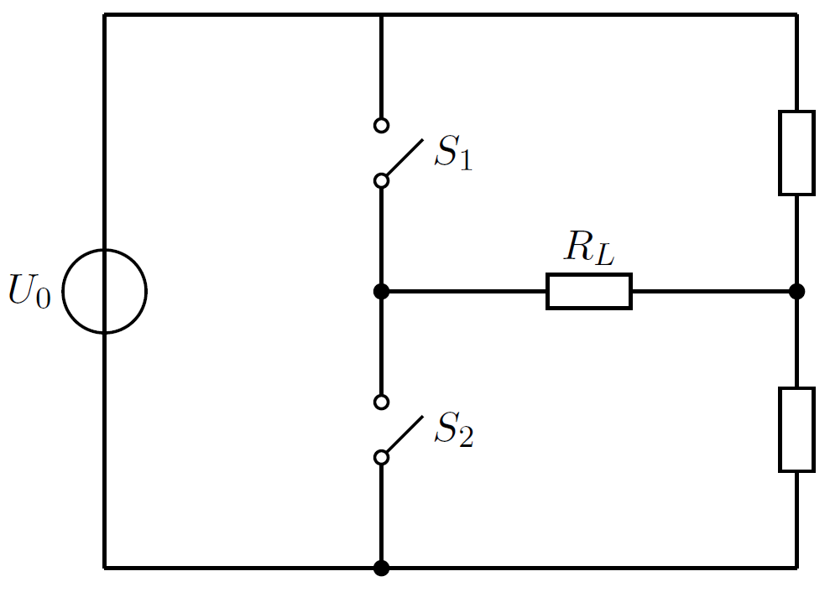
Half bridge

Slide 17
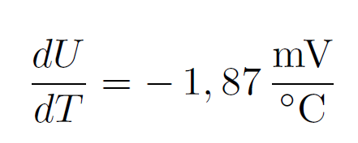
Diode temperature dependence
with
=>
for
Temperature dependence of leakage current
Watch „thermal run-away“ in detector applications

Slide 18
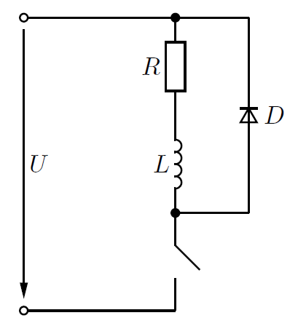
Protection circuits
For closed switch diode is reversed biased.
Negligible diode current. U_{L} = 0 V.
For open switch U_{L} is rising, diode starts conducting.
Inductor supports current flow until magnetic energy is fully dissipated in resistor.

Slide 19
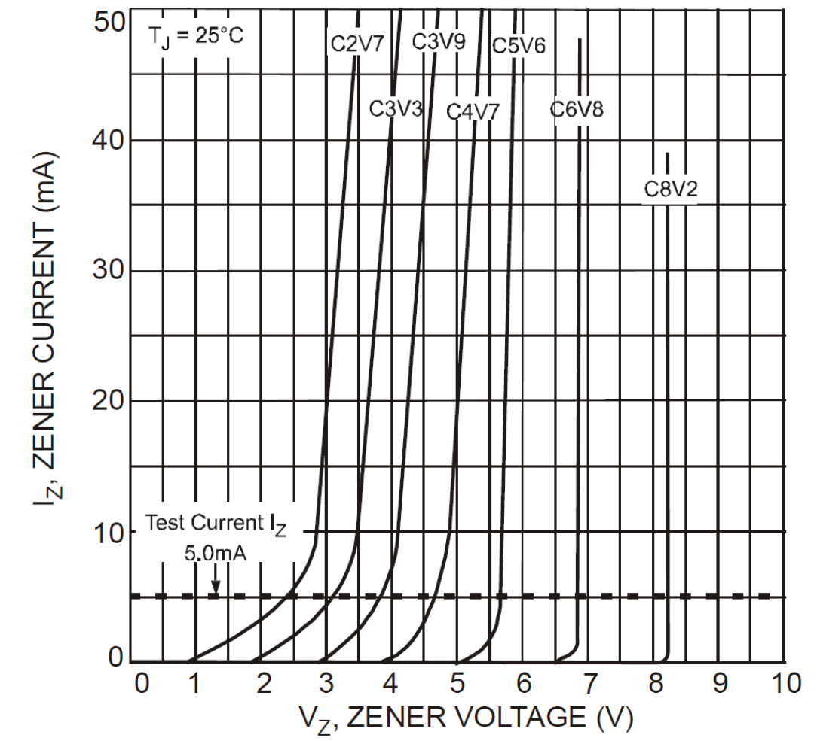
Zener diode

Slide 20
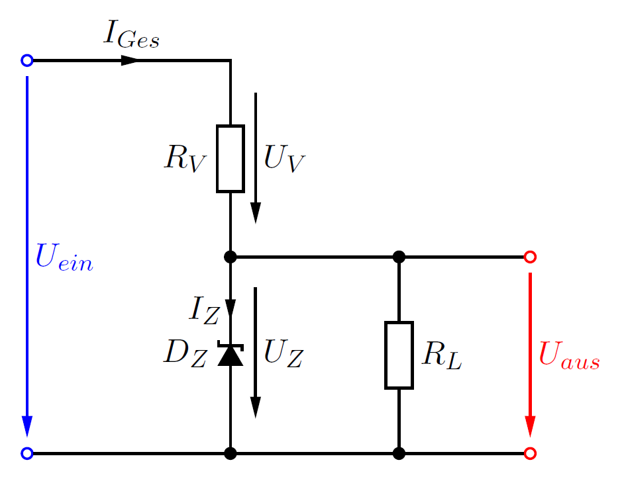
Zener diode as voltage regulators
This makes sense for small load currents.
Otherwise circuit draws too much power.

Slide 21
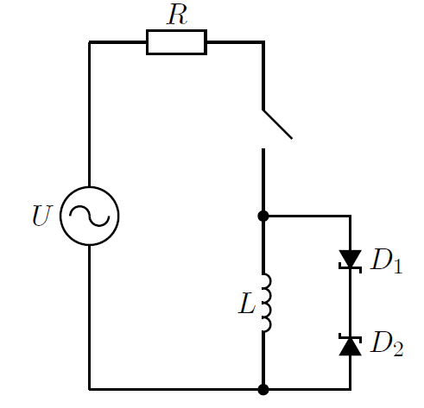
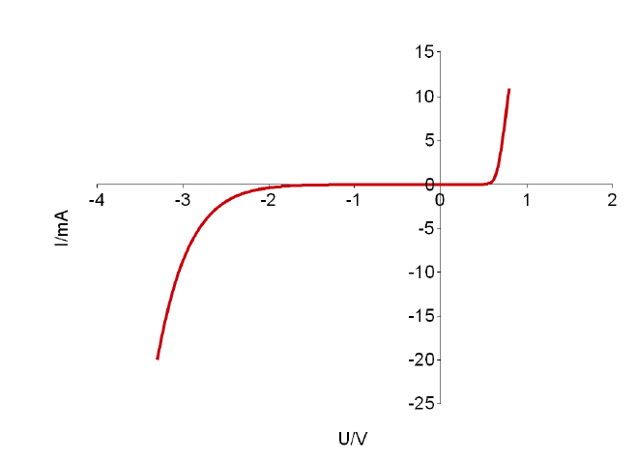
Protection with Zener diodes
+ I_{L}
-I_{L}
For closed switch U_{L} = 0. Diode current is negligible. For open switch U_{L} is rising until both diodes conduct.
Note that D₂ conducts in normal mode. D₁ in break-down region

Slide 22
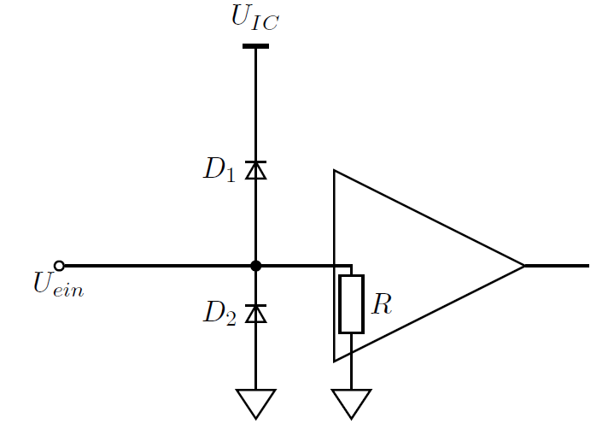
Protection circuits (continued)
If U_{ein} > U_{IC} + 0.7 V: D₁ is conducting, D₂ is not.
If U_{ein} < -0.7 V: D₂ is conducting, D₁ is not.
Large currents into IC are prevented.
Large voltages are shorted to ground.

Slide 23
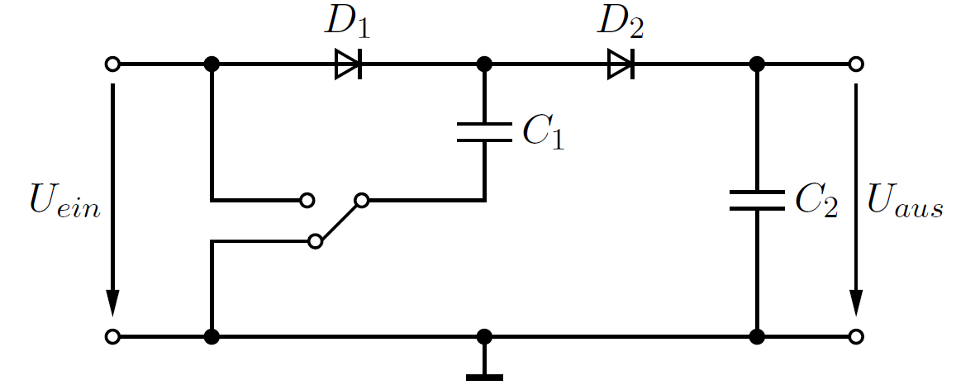
DC – DC converter/ voltage doubler
1
2
If switch is connected to 2, D₁ is conducting, D₂ not
If switch is connected to 1, D₂ is conducting, D₁ not

Slide 25
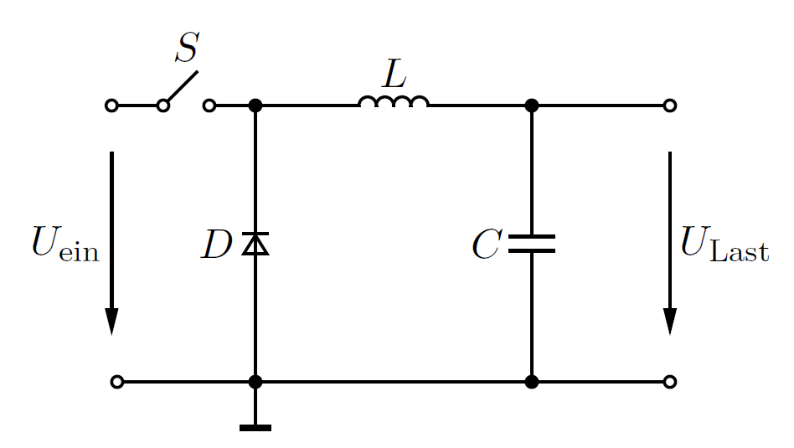
DC – DC converter/ buck converter
Duty cycle
This is a popular and simple step-down converter

Slide 27
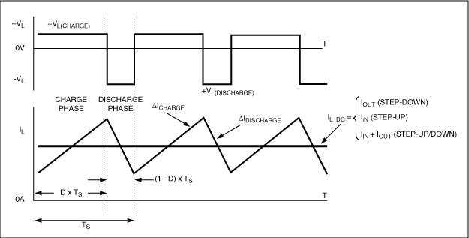
DC – DC converter/ buck converter

Slide 28
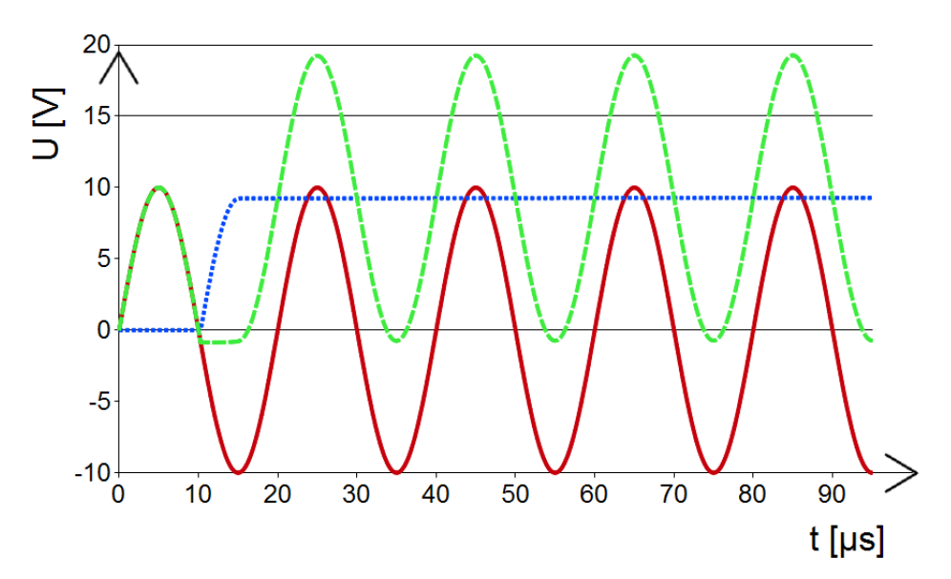
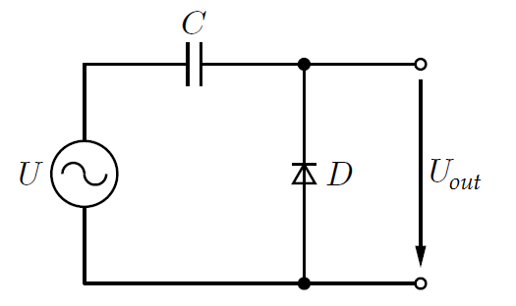
Voltage doubler
Villard circuit
0 V
Compared with rectifier, capacitor and diode positions are swapped.
Initially U_{C} = 0 V. Whenever U_{in} > 0 V, diode is blocked.
During first negative voltage swing with U_{in} < 0.7 V, diode is conducting and capacitor is charging up.
With next positive input voltage swing, output sees sum of cap and input voltage.

Slide 29
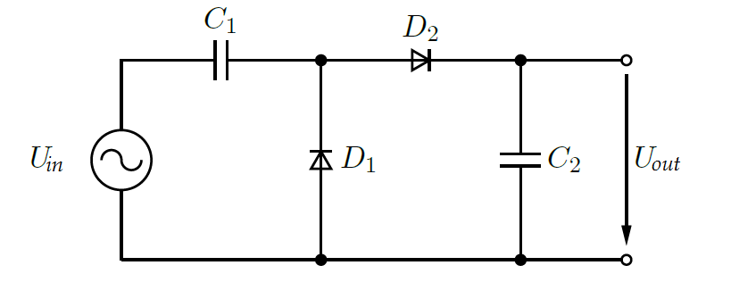
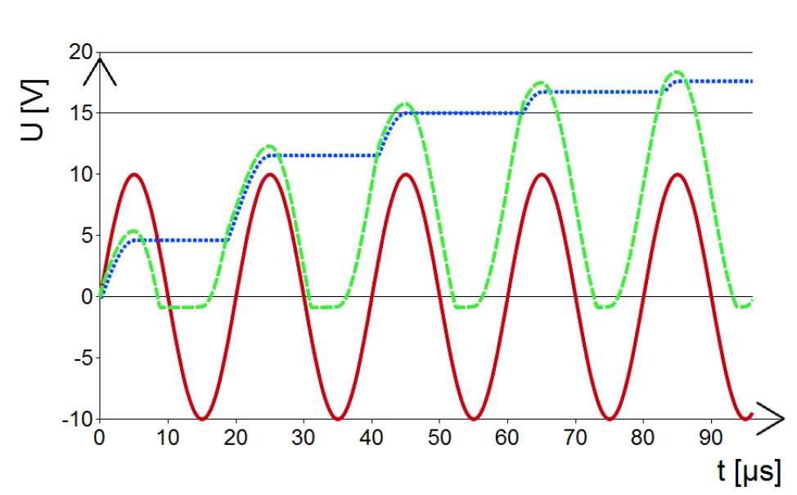
Greinacher Circuit
Here another rectifier circuit is added. Thus output is DC voltage.

Slide 30
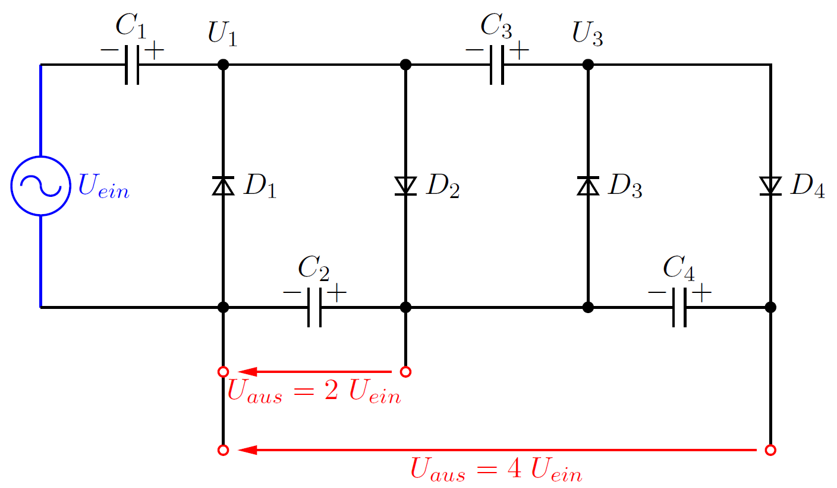
Cascade voltage generator

Slide 31
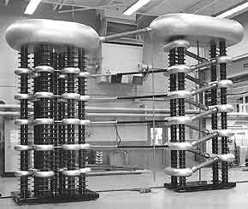
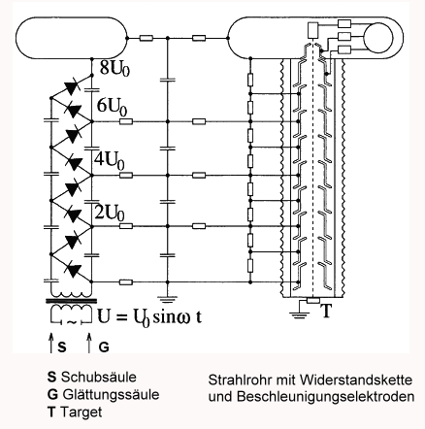
Cockroft Walton generator
http://www.relativ-kritisch.net/forum/viewtopic.php?t=1261

Slide 32
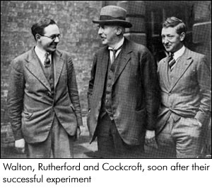
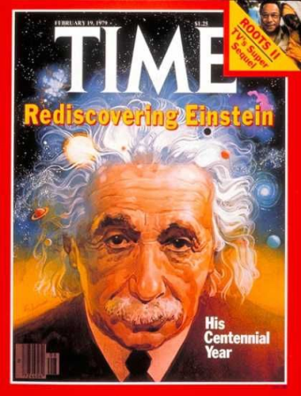
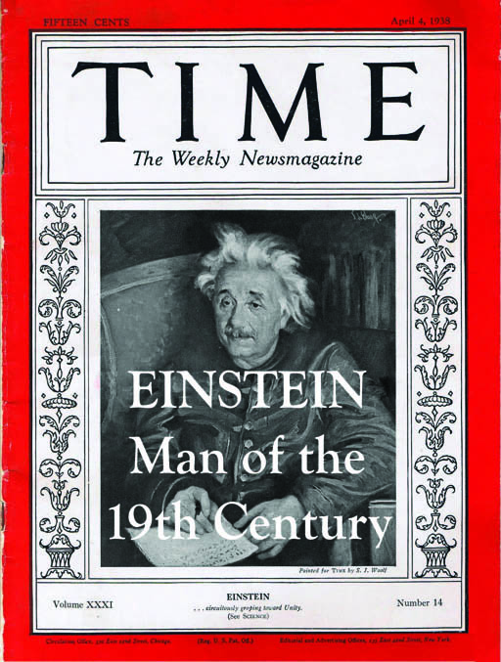
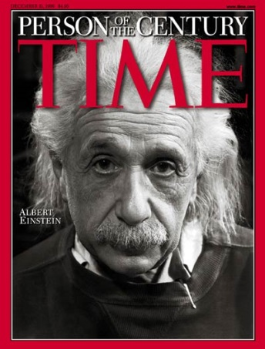
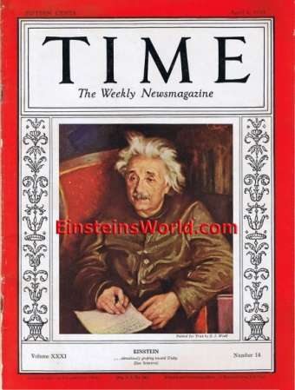
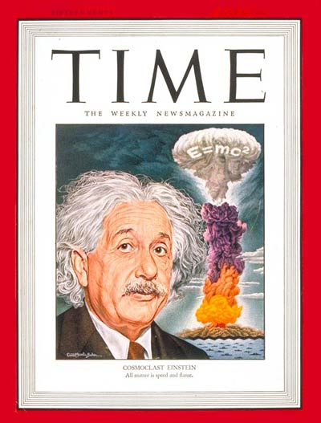
Strong interaction
Strong force is responsible for existence of proton and neutron, for nuclear forces, nuclear fission and fusion.
In PP strong force acts on quarks and gluons
Early examples of the strong interaction:
“Splitting the atom” p + ⁷Li → α + α + 17 MeV
1.007 + 7.0160 ≠ 2 x 4.0226 → mass deficit
First experimental proof for E = mc²
in 1932
Nobelprize for Cockroft and Walton in 1951

Slide 33
Consequences of SR
Modified rules for adding velocities
Time dilation
Length contraction
Relativistic momentum :
Energy in rest frame corresponds to mass at rest
Listen to the expert…

Slide 34
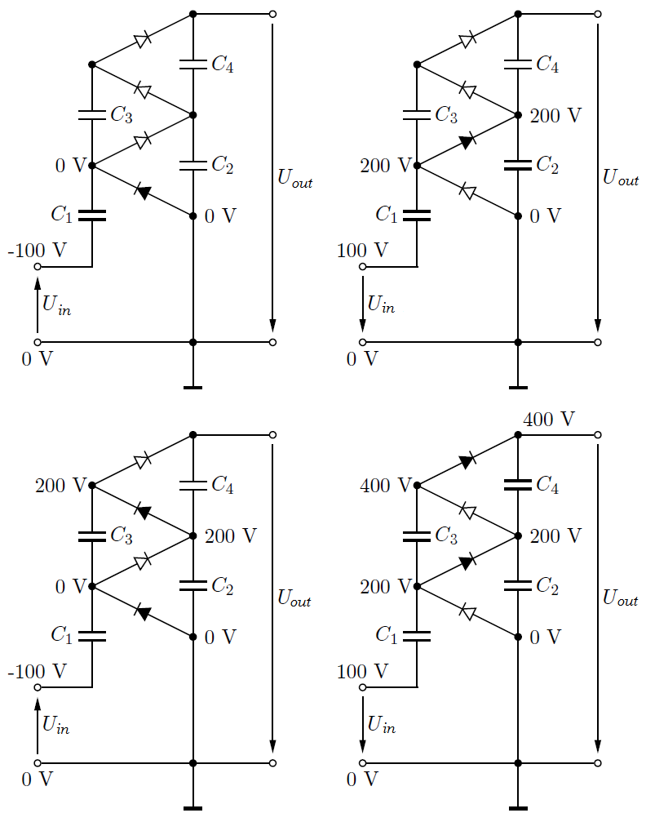
Cascade voltage generator (cont.)

