Slide 1

Electronics for physicists
Lecture 4
Operational Amplifier

Slide 2
Introduction
OPVs are many transistors at once
OPVs are good and cheap
Disadvantage: too bulky for systems with many read-out channels

Slide 3
What are ap amps good for?
Universal flexible amplifies of voltages and currents
Charge-sensitive amplifiers
Buffer
Comparator
Active filters
Components in ADCs and DACs
…

Slide 4
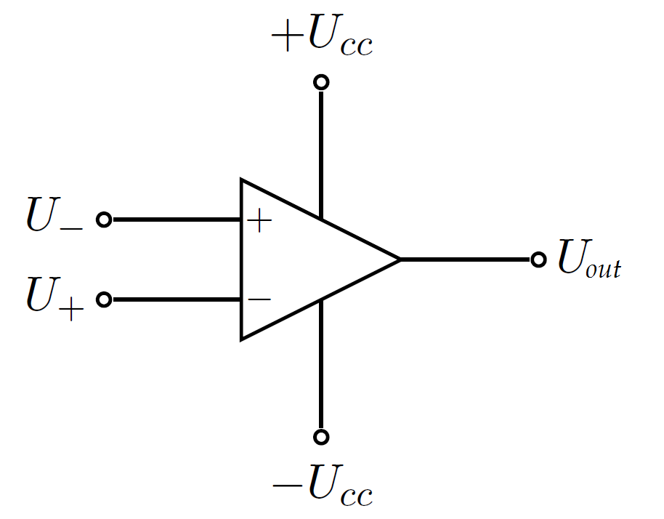
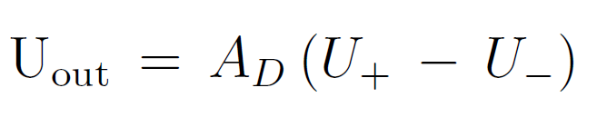
Operational amplifier (op-amp)
High-gain differential amplifier block
Differential input, single-ended output (usually)
Differential input is flexible and helps suppress noise sources
"+" non-inverting input;
"-" inverting input
A_{D}: gain, best large e.g. 100 000

Slide 5
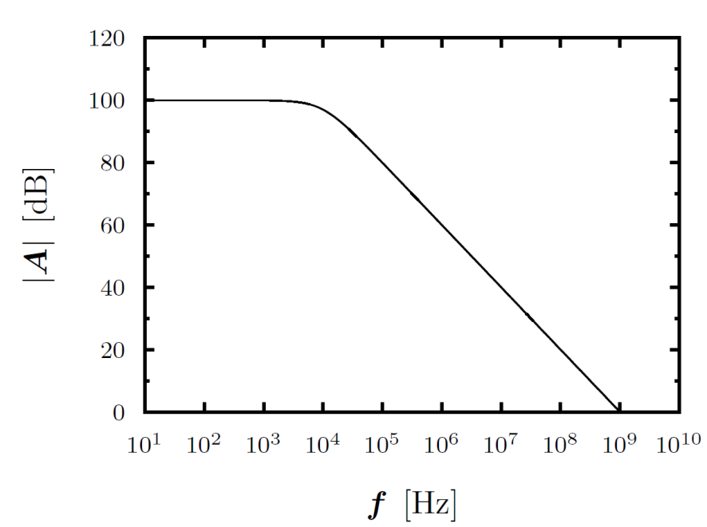
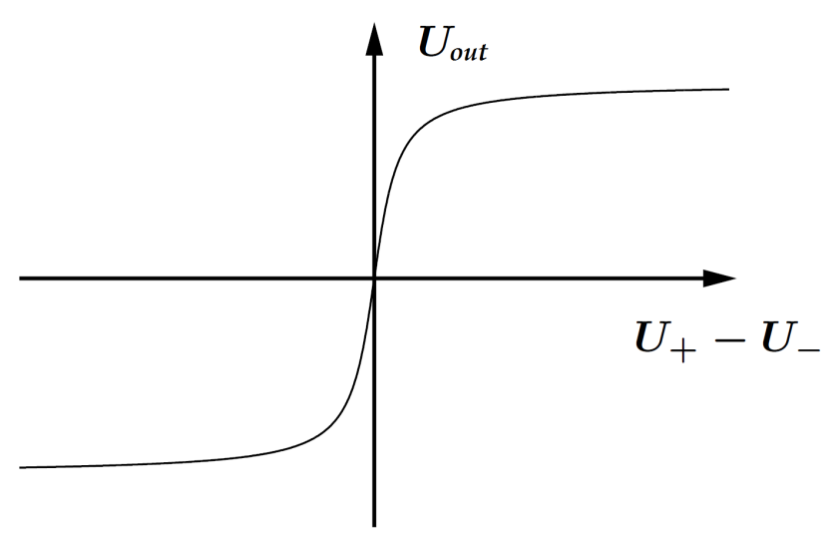
Operational amplifier (op-amp)
Saturation
Low-pass behavior
(dominant pole)
Linear range
Gain as a function of input voltage and of frequency
Op-amp gain A_{D} should be large and constant
Alas, this is not always so. Gain depends on input voltage, frequency and temperature …

Slide 6
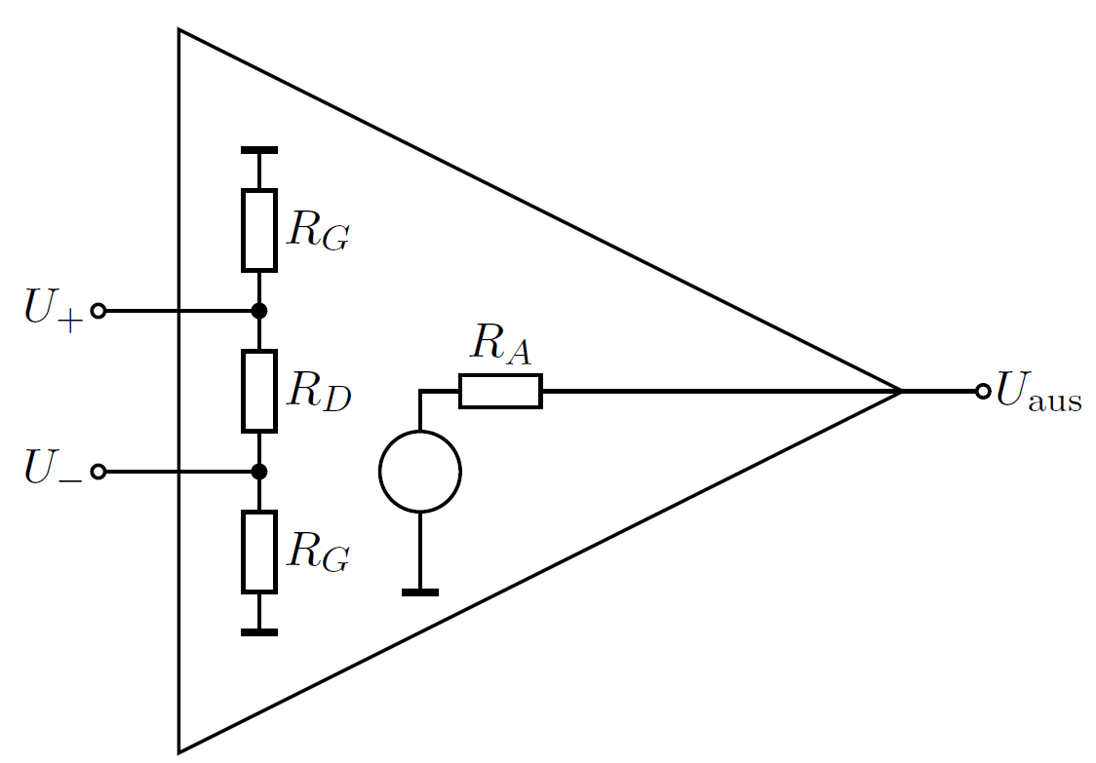
Op-amp as black box
Input resistance R_{G} is very high, minimum MΩ to GΩ
Output impedance R_{A} is low (voltage source)
Simplified op-amp circuit diagram. Supply voltage is not shown.

Slide 7
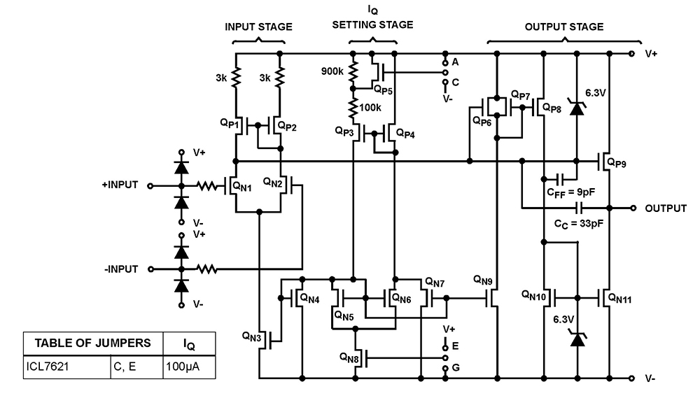
Operational amplifier ICL7621
ICL7621 (Intersil) schematic
10¹² Ω input impedance, 200 µW power, ±1V to ±8 V supply voltage, 75 db voltage gain, 2 µs rise time, 0.48 µs GBP, low-noise

Slide 8
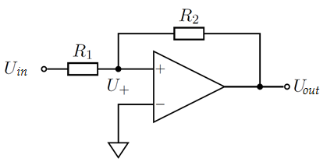
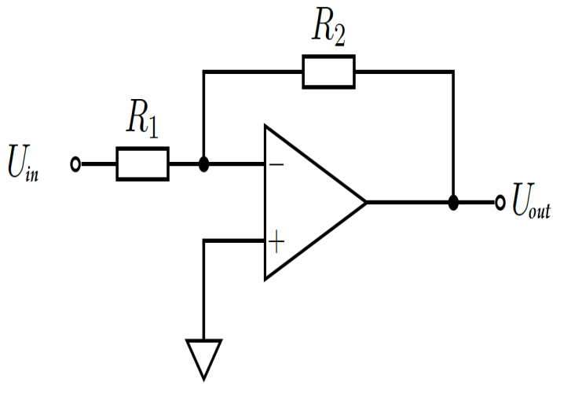
Positive and negative feedback
Schmitt trigger
Inverting amplifier
Feedback:
Some fraction of the output voltage is fed back to the op-amp input
Feedback can be positive (to non-inverting input) or negative (to inverting input)
We will mostly consider negative feedback below.

Slide 9
Schmitt trigger
+ U_{cc}
U₋
- U_{cc}
Positive feedback increases U₊ for positive input voltage
U_{aus} is driven to equal U_{max} ⇒ trigger function
Output signal is essentially binary with two states:
U_{max} ≈ + U_{CC} , U_{min} ≈ - U_{CC}

Slide 10
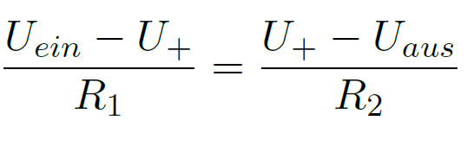


How to switch states?
Assume U_{aus} = U_{max}
Need U₊ ≤ 0 to change output polarity
With and
⇒
changes output voltage to U_{min}

Slide 11
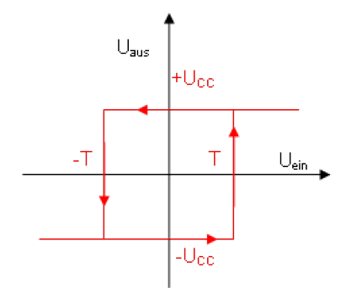
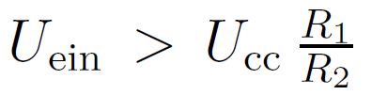
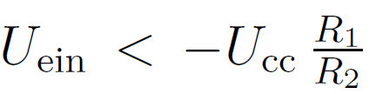
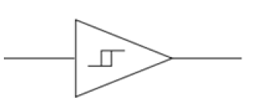
Schmitt trigger hysteresis
Need strong input signal to overcome positive feedback ⇒ hysteresis.
or
Schmitt trigger symbol

Slide 12

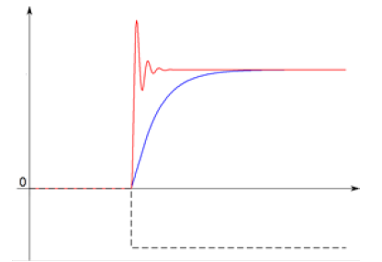
Inverting amplifier
Inverting amplifier
voltage
Fast op-amp
Fast op-amp shows overshoot and some ringing
Slow op-amp is fine but slow
slow op-amp
time
Input signal

Slide 13
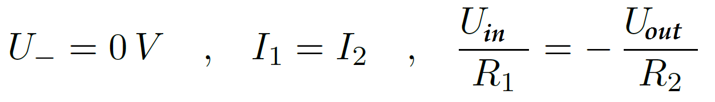
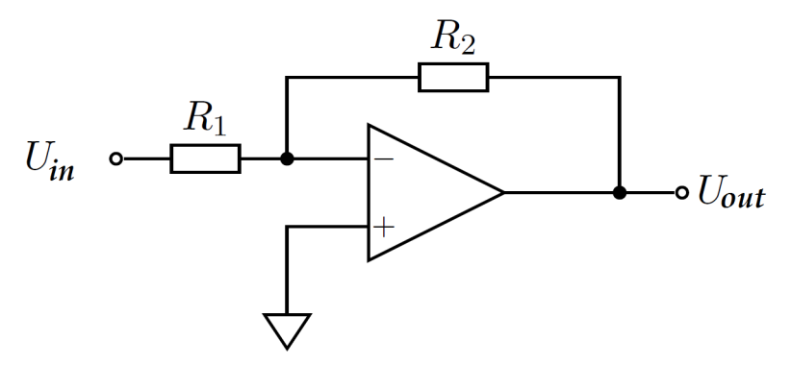
Golden rules
To analyse circuits with negative feedback we assume:
U₊ = U₋ Note: U₋ differs from U_{in} due to feedback!
The op-amp input impedance is infinite. (No current flows into op-amp.)
The op-amp output impedance is small. (Output voltage does not depend
on load and output current.)
For the inverting amplifier, this results in:
(virtual ground)
I₂
I₁

Slide 14
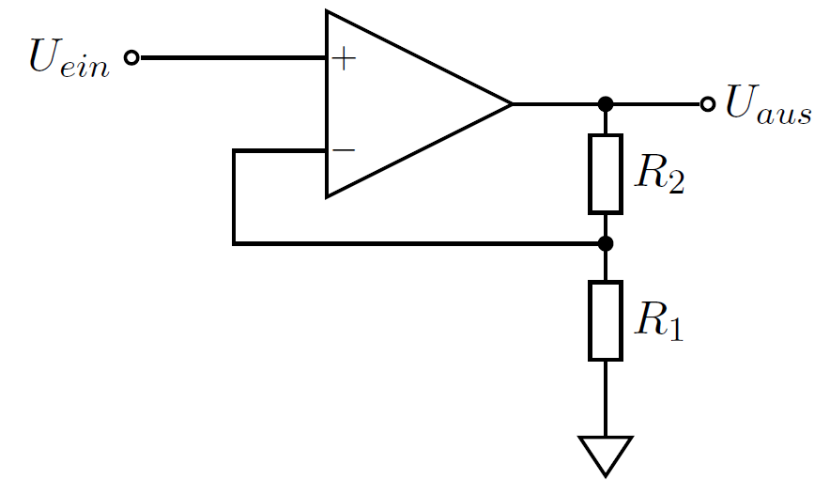
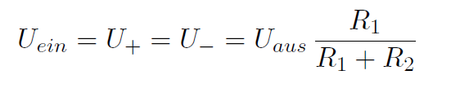
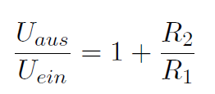
Non-inverting amplifier
Input voltage is applied to non-inverting mode
With golden rules:
Thus

Slide 15
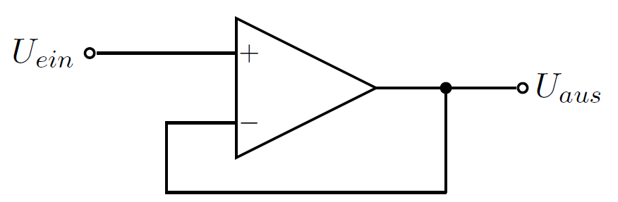
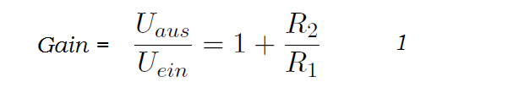
Voltage buffer
This circuit is a non-inverting amplifier with R₁ = ∞ and R₂ = 0.
≈
What is the point of this circuit?
Output can provide larger current than unbuffered input.

Slide 16
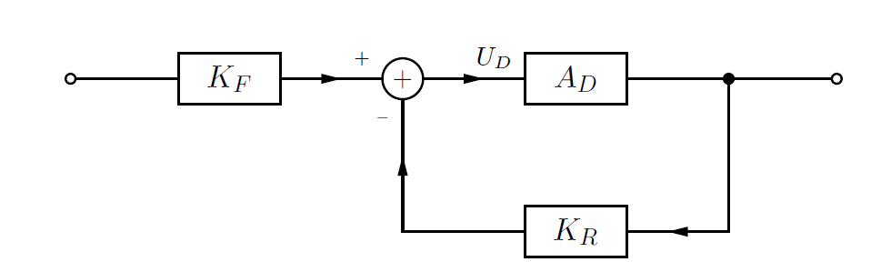
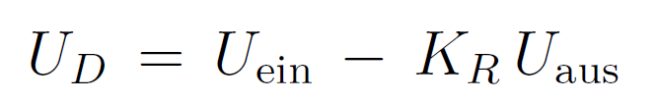
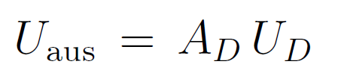
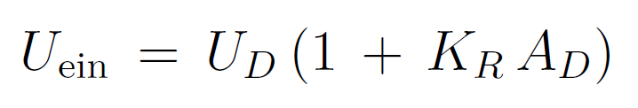
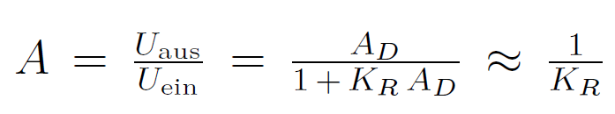
Operational amplifier as a control loop
Assuming op-amp output settles into a stable state, we can easily calculated gain…
For simplicity, we set K_{F} = 1.
and
⇒
and

Slide 17
Definitions
Examples:
A_{D}: 100 K
K_{R} : R₁/(R₂ + R₁) = 1/11, A ≈ 10
K_{R} A_{D}: 10⁴
A_{D}: open-loop gain
Leerlaufverstärkung
A: closed-loop gain
Verstärkung mit Rückkopplung
K_{R} A_{D}: loop gain
Schleifenverstärkung

Slide 18
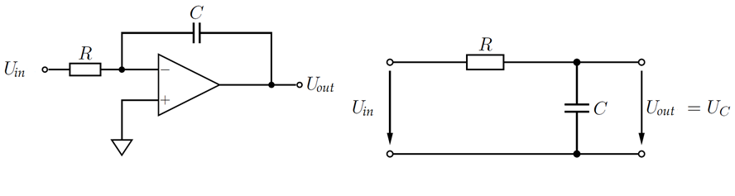
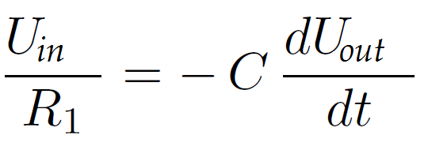
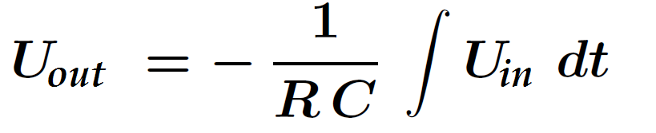
Charge-integrating amplifier (CIA or CSA)
Integrator
Passive low-pass
⇒
C is being charged up. Output voltage is going down!
What is the difference between “active” and “passive” integrators?

Slide 19
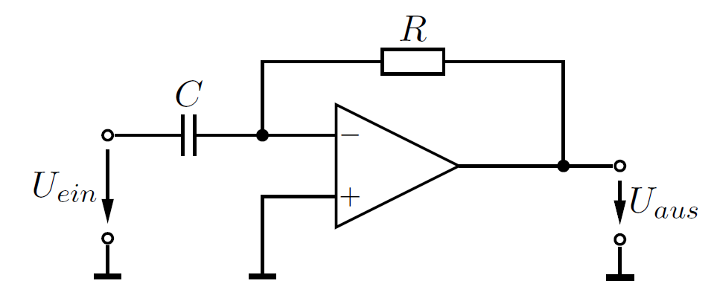
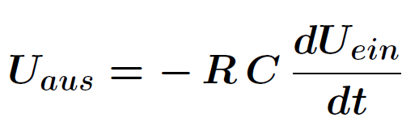
Differentiator
With golden rules:
The „active“ differentiator is much superior to passive CR differentiator. Why?

Slide 20
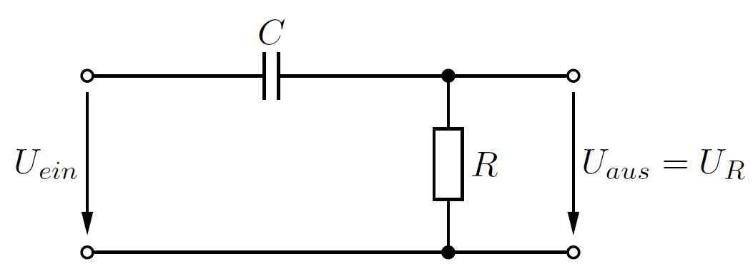
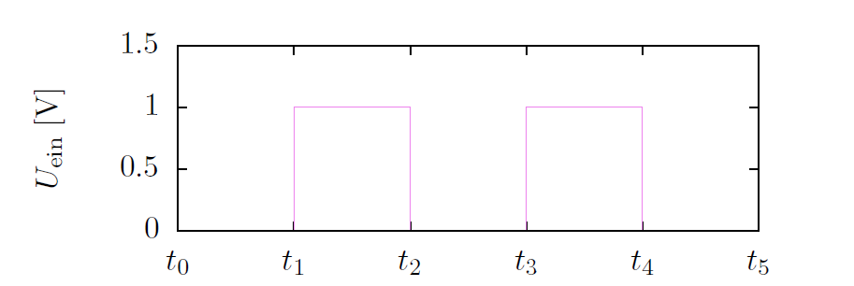
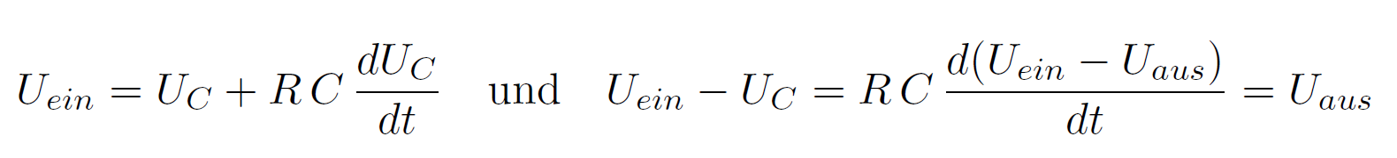
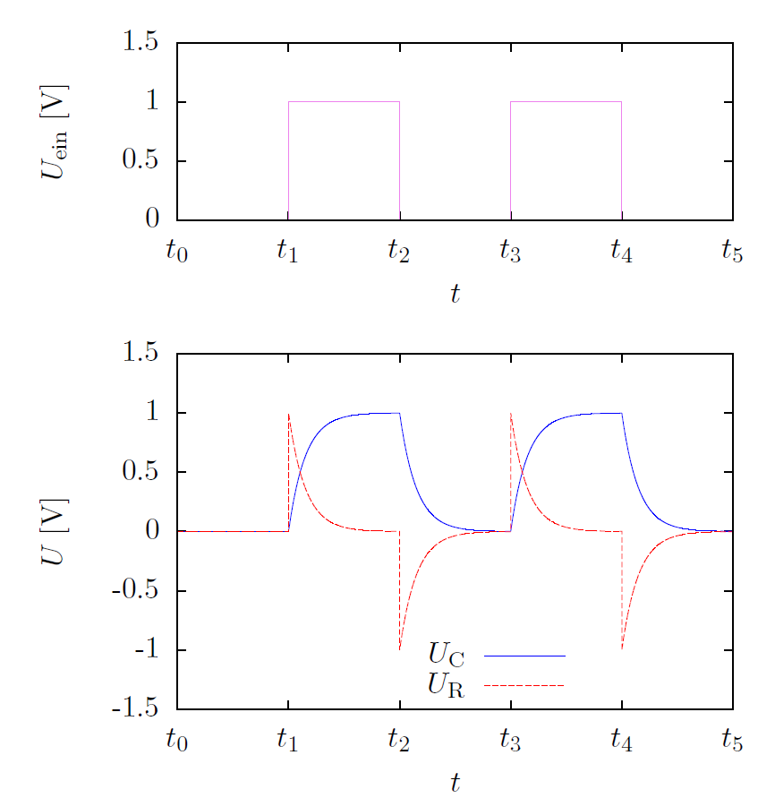

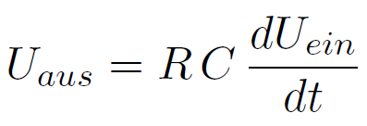
High-pass
For or
small R this reduces to

Slide 21
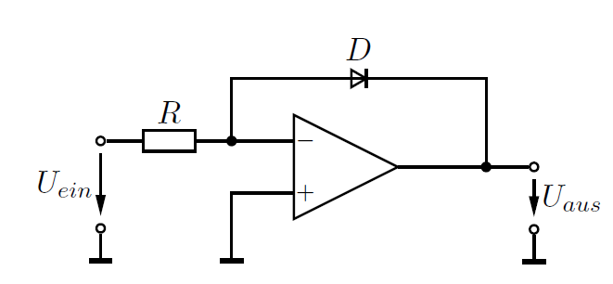
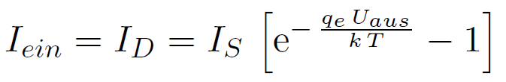

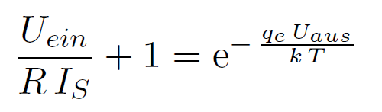
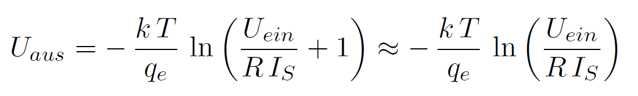
Logarithmic amplifier
With and
⇒ and

Slide 22
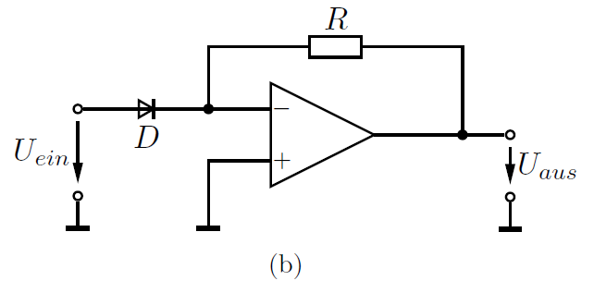
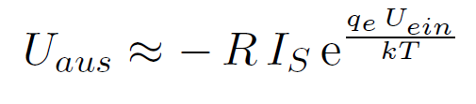
Exponential amplifier
Here the diode and resistor positions are swapped.

Slide 23
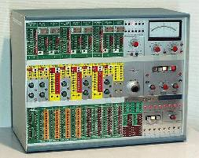
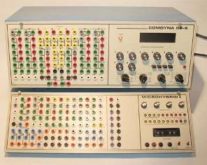
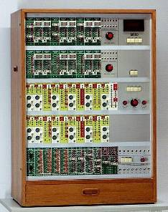
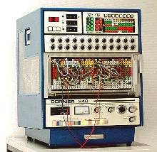
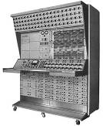
Analog / Electronic (Transistor / IC)
In the 50s and 60s (even 70’s) electronic versions of the analog computer were available
Generally consisted of Op Amps with the ability to connect them to add, subtract, multiply integrate, etc.

Slide 24
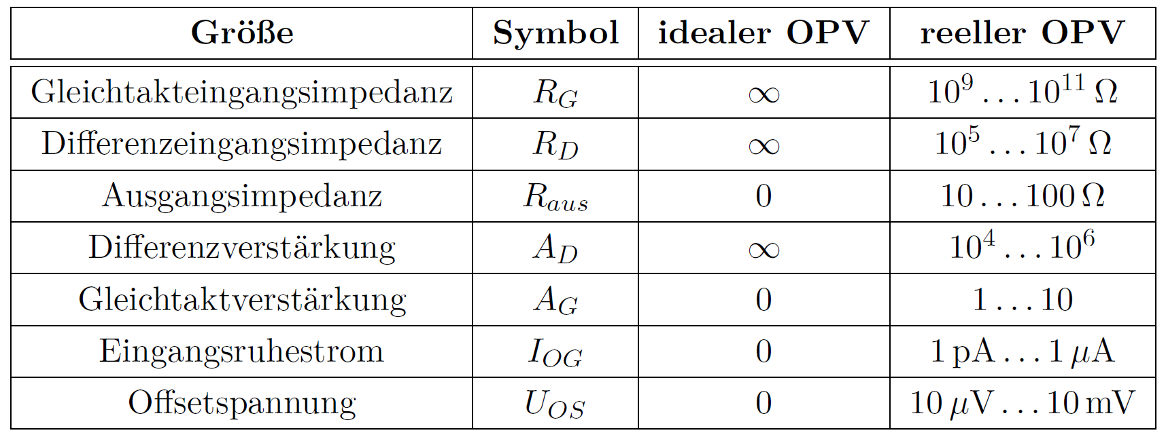

Real op-amps
Parameters of real and ideal op-amps. Values without feedback.
Ratio A_{D}/A_{G} should best be very large

Slide 25
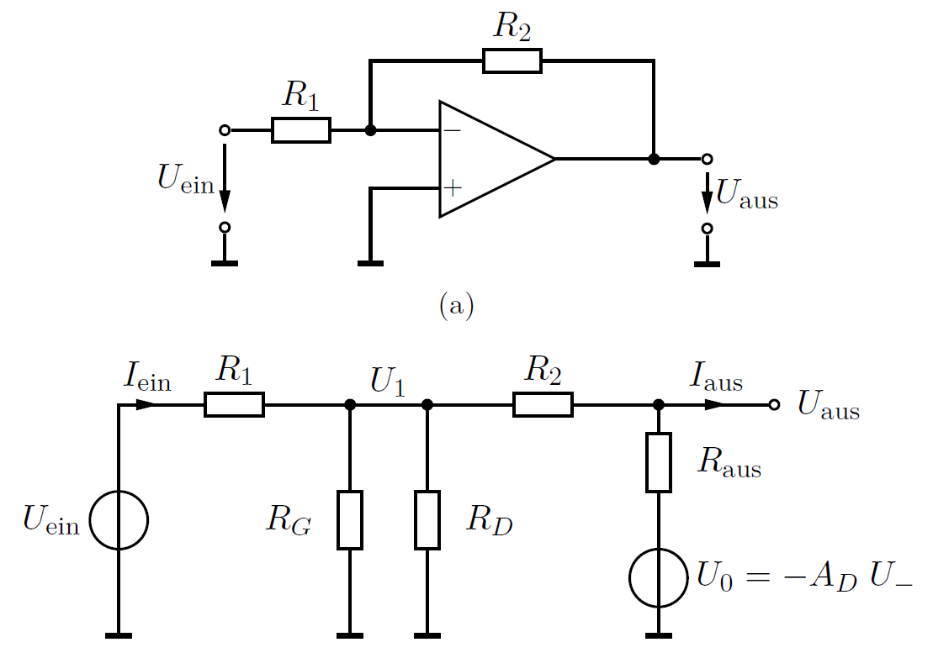
Equivalent circuit of inverting amplifier
U₋ = U₁ corresponds to the voltage on the inverting input
Apply superposition principle. Assume I_{aus} = 0 and R_{G} >> R_{D}

Slide 26
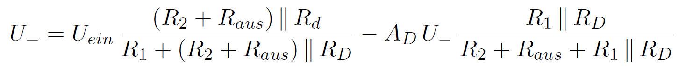


Equivalent circuit of inverting amplifier
U₋ is approx. 0 V (virtual mass)

Slide 27








Op-amp gain frequency response
Most op amps are tailored to look like first-order
low-pass (dominant pole):
How does negative feed-back influence
the frequency response?
If f << f_{g} : (indep. of frequency!)
If f >> f_{g} : and
1,000
1,000

Slide 28



Gain vs. bandwidth
Gain-bandwidth-product (GBP)
1,000
f₀ = frequency at gain 1 (= 0 db)
1,000
One can trade off bandwidth and gain.
Reducing the amplification by a factor ten increases bandwidth by ten.

Slide 29






Oscillators
There are two stable output voltage states:
Square wave generator

Slide 30

Phase shift oscillator
A stable oscillation requires a combined op-amp and feed-back phase shift of ± 360°
What is the phase shift of the three low-passes?

Slide 31

Bode plot of first-order low-pass

Slide 32

Many low-passes…
Maximum phase shift increases to n times -90°
Steepest slope at ω_{-3db}
From: „Op amps for
everyone“

Slide 33

Phase shift oscillator
φ = -60°
φ = -60°
φ = -60°
U_{ein}
U_{aus}
φ = -180°
No external input
If phase shift of feed-back signal is ±360°, circuit may oscillate.
Resonance frequency depends on RC (here oscillation at ω = 1.73/RC)

Slide 34

Another phase shift oscillator
Chain of active integrator (op-amp), two low-pass filters and voltage buffer (op-amp).
Adjustable resistor acts as feed-back between op-amp 2 output and op-amp 1 input.
No external input! (Op-amp power supplies are not shown.)

Slide 35











Oscillation condition
Assume stable oscillation with frequency ω and period T:
Let´s calculate U₂ from U₁ , U₃ from U₂ ,etc:

Slide 36




Oscillation condition
Thus
Imaginary part = 0 →
Real part = 1 →
Questions: Why 2 low-pass filters, rather than 1?
What is the output voltage?

Slide 37
Oscillator explained
Distinguish three scenarios …
Loop gain A_{D}K_{R} >> 1:
Strong feed-back and limited amplification
→ stable output, no oscillation, A ≈ 1/K_{R} => Good!
Loop gain << 1:
Weak feed-back, very strong amplification, output tends to saturate A ≈ A_{D}. => Not ideal for amplifier, but good for comparator.
If |A_{D}K_{R}| ≈ 1, we have to watch the sign of A_{D}K_{R}.
For A_{D}K_{R} ≈ +1, see 2.
For A_{D}K_{R} ≈ -1: => Oscillating condition (Barkhausen criterion)!
  For one negative feed-back turns into positive feed-back. Also the value of A_{D} saturates, the effective feed-back is reduced. This is the oscillation condition.

Slide 38
From amplifier to oscillator
Why is A_{D}K_{R} ≈ -1 bad for amplifiers?
For one negative feed-back turns into positive feed-back.
Also the value of A_{D} saturates, and the effective feed-back is reduced.
Consider U_{ein} to be small. Then K_{R}A_{D} = -1 implies:
U_{aus} (T) = - K_{R} A_{D} U_{aus} (t=0) = + U_{aus}(t = 0)
U_{aus} (t = 0) = U_{aus} (T) is compatible with oscillation.

Slide 39



Phase margin
|A_{D}| = $\frac{1}{β}$
A_{D} K_{R} ≈ -1: => oscillating condition,
Barkhausen criterion!
Phase margin 90°
Rule of thumb: need $≥45°$ of phase margin for stability

Slide 40

AC-DC converter

Slide 41


Slide 42

A more abstract view of feed-back

Slide 43


Inverting Op-amp
Current-to-voltage converter
Shunt-shunt feed-back
Feed-back reduces input impedance
Feed-back reduces output impedance
A =
dV_{out}
_____
dI_{in}

Slide 44

Non-inverting Op-amp
A =
dV_{out}
____
dV_{in}
Series-shunt feed-back
Feed-back increases input impedance
Feed-back reduces output impedance

Slide 45

Feed-back makes for 4 op-amp types

Slide 46

Negative impedance
Resistances R are positive and U = RI
With active circuit elements, negative impedances can be constructed! How?
Positive and negative feedback!

Slide 47




Negative impedance converter (NIC)
Negative current ⇒ negative resistance

Slide 48



Gyrator
Definition:
Circuit:

Slide 49




Gyrator
⇒
with

Slide 50



Amplifiers vs. oscillators
Feed-back yields closed-loop gain of
If $ADKR$ $≫1$, amplifier is stable and
If $ADKR$ $=− 1$, amplifier oscillates (Barkhausen criterion)
Thinking in phase and amplitude, Barkhausen implies:
  a net phase shift of 180° (through passive filter network)
  a loop gain of 1
For stable frequency need well-defined oscillation condition and thus large dφ/d$ω$
$\frac{Uaus}{Uein}$= $\frac{AD}{\begin{aligned}1 + AD KR \\ \end{aligned}}$
$\frac{Uaus}{Uein}$ = $\frac{1}{\begin{aligned}KR \\ \end{aligned}}$

Slide 51

Wien bridge oscillator
Circuit elements:
1 op-amp
2 capacitors
4 resistors
1 R-diodes circuit
Wien bridge oscillator produces sinusoidal oscillation at a given frequency.

Slide 52



Circuits elements
Negative feed-back loop through R₁₀ + R₁₁ + R₁₂ defines gain
R₁₂ and diodes make sure gain at start-up is larger than later
Positive feed-back is constrained by band pass.
At resonance frequency, phase shift is 0° and band-pass output maximum
1 + $\frac{R11 + R12}{R10}$
1 + $\frac{R11 }{R10}$
vs.
U₊ = $\frac{1}{3}$ U_{out}

Slide 53
Appendix

Slide 54
Charge integrating amplifier
Integrator
Consider a current signal at the input of the op-amp
The current is converted into a voltage with gain dU_{out}/dI_{in} = 1/C_{F}
To be considered:
noise and equivalent noise charge (ENC)
C_{i} / C_{D}
discharge of feedback capacitor
1/C_{F} = gain; A high
detector system with complete circuit including diode in reverse direction, filter, op-amp, etc.

