Slide 1
Electronics for physicists
Chapter 5

Slide 2
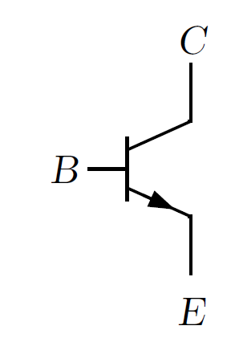
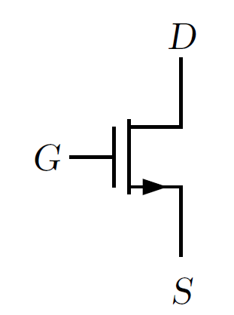
Transistor
The transistor was one of most influential inventions of last century.
A transistor is an active, non-linear electronic component.
Bipolar npn transistor
NMOS

Slide 3
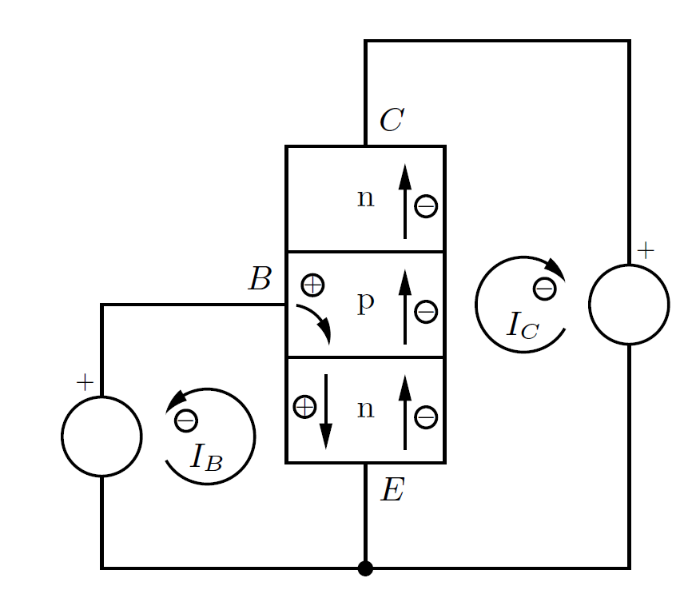
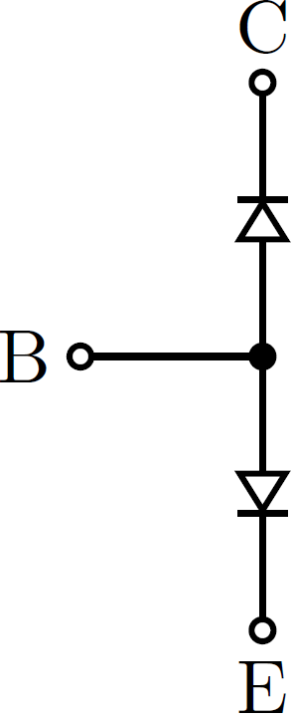



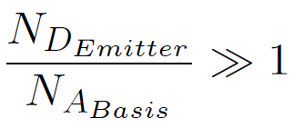
Bipolar transistor basics
npn transistor
Collector-base-emitter
Reverse bias
Forward bias
source: H. Spieler
Base current (voltage) drives collector current.
Key requirements:
Base layer is shallow.

Slide 4
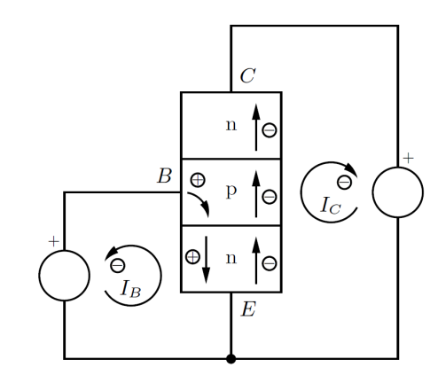
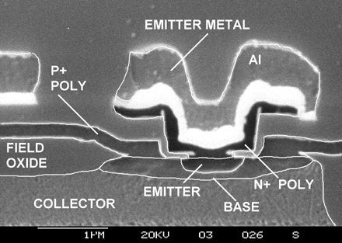
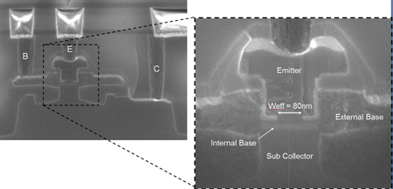
Cross sections of realistic transistor
Source: IMEC
Source: Raytheon

Slide 5
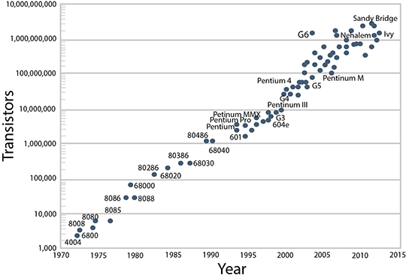
Moore‘s law
Where else is technological progress so fast?
Who/what is driving transistor technology?

Slide 6
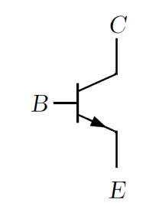
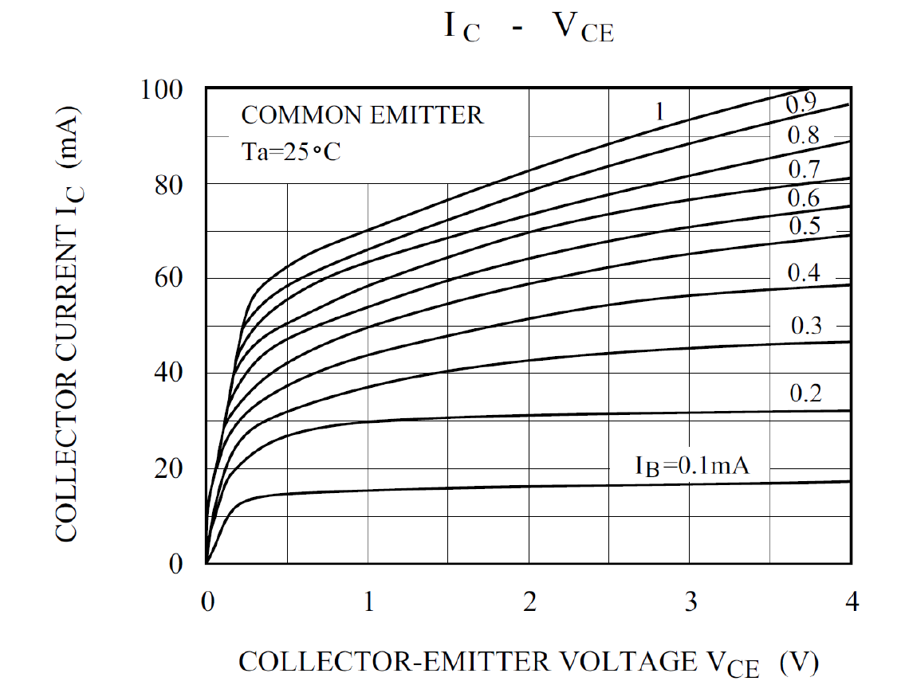
I-V curves
With 3 terminals need to distinguish I_{C} vs U_{BE}, I_{B} vs U_{BE}, I_{C} vs U_{CE} …
Knowledge of I-V curves is all what’s needed for circuit design
Watch power limit U_{CE} I_{C} < P _{max}

Slide 7
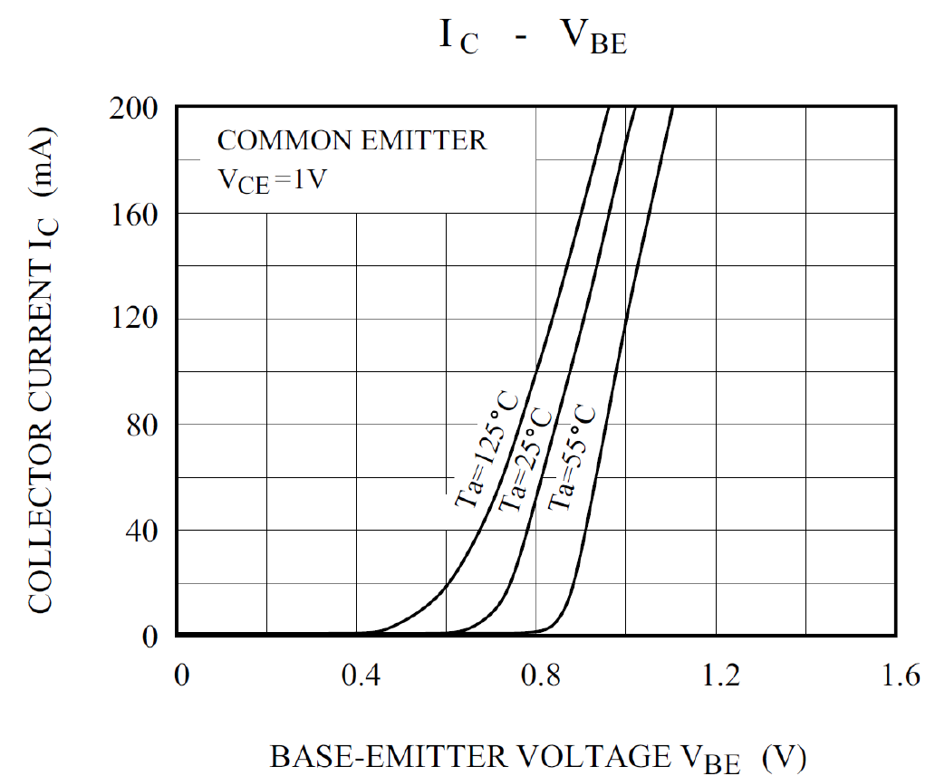
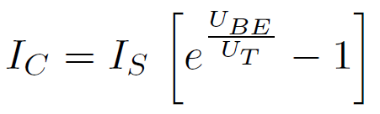
I_{C} vs U_{CE}
U_{BE} drives collector current I_{C}
Diode-like behaviour with large I_{C}
Transistor is active device with amplification

Slide 8
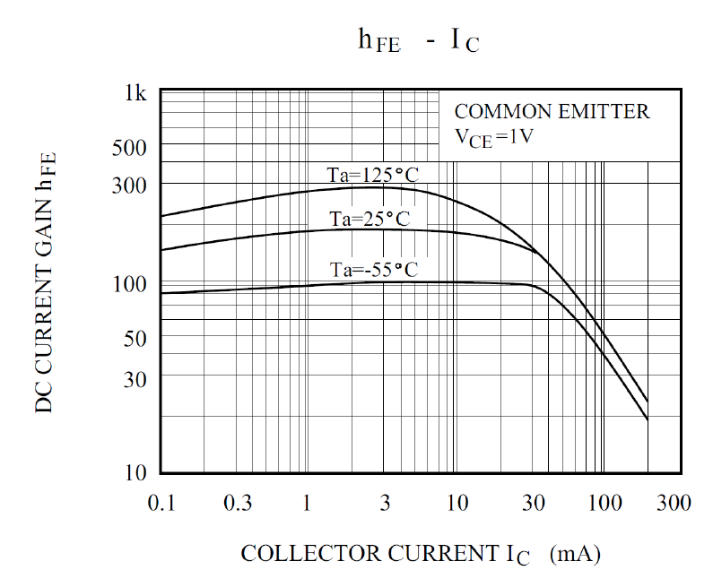

I_{C} vs I_{B}
In good approximation:
β ≈ 100 (Much larger β can be realized in modern technologies.)
A bipolar transistor is often considered as a current-driven current source.

Slide 9
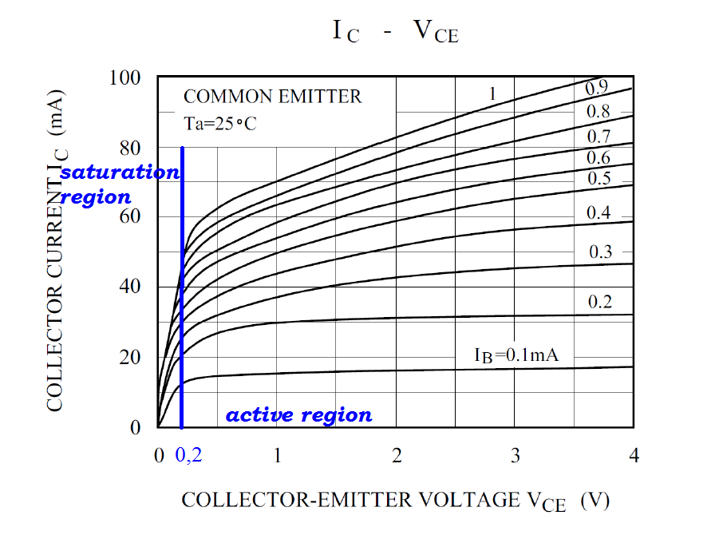
Review of I_{C} vs U_{CE}
Need to exceed minimum U_{CE} for collector-emitter-current I_{C} to flow
In active region I_{C} does not vary much with U_{CE} (differential resistance R_{CE} is large)
I_{C} >> I_{B}
Homework: relabel plot by replacing I_{B} by U_{BE} value

Slide 10
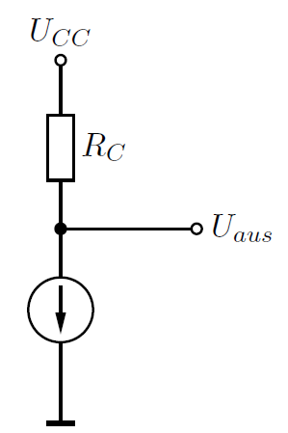
Transistors in circuits
Voltage amplifier configuration
Transistor current causes voltage drop R_{C} I_{C} . Thus dU_{aus} = - R_{C} dI_{C}
Current flows through R_{C} and transistor (current source). No or little current goes into output node.
Note that the absolute value of U_{aus} (the working point) is not defined yet.

Slide 11
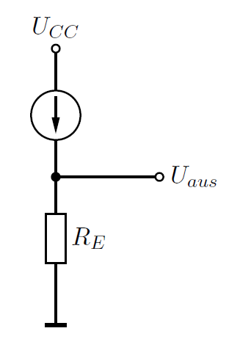
Current amplifier
(voltage buffer)
Here I_{C} may flow through either R_{C} or the output node.
If R_{E} >> load impedance, circuit acts as a buffer.
U_{aus} is related to U_{Base} (U_{aus} = U_{Base} minus one diode drop).

Slide 12
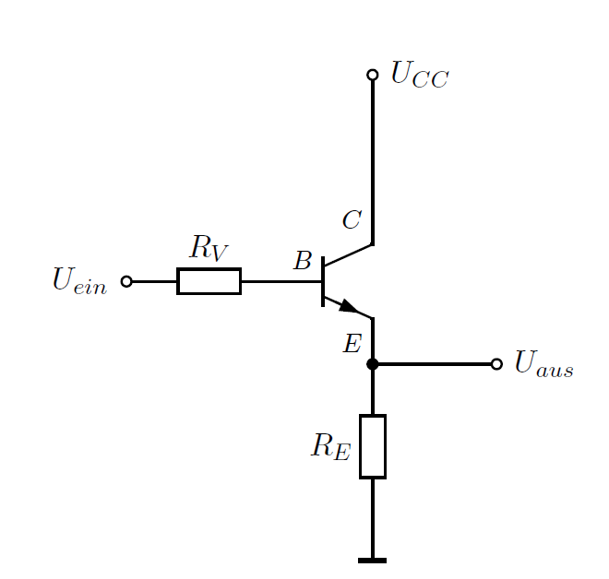
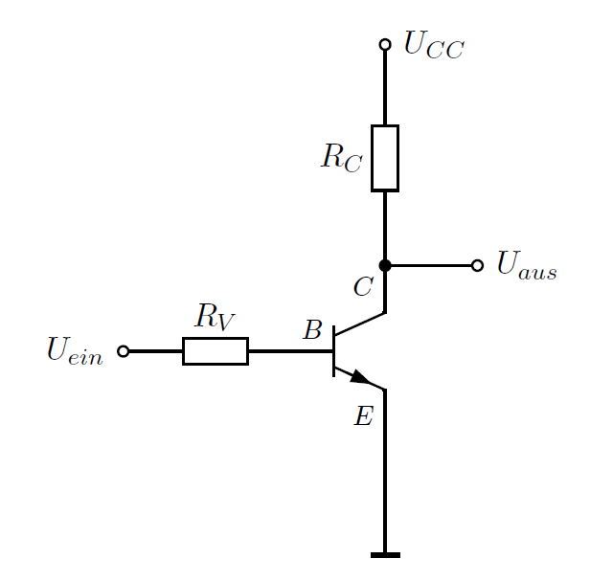
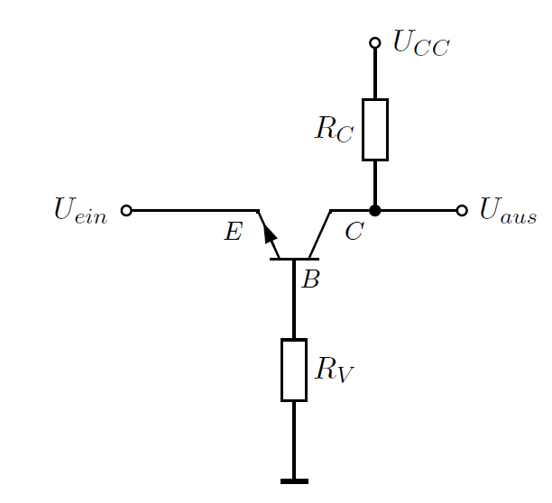
1T - circuits
common emitter amplifier (voltage amplifier)
common collector amplifier (buffer)
common base amplifier (voltage amplifier)

Slide 13
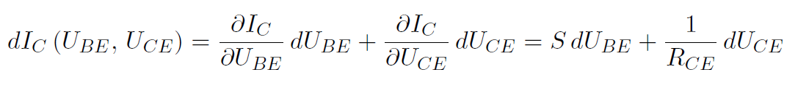
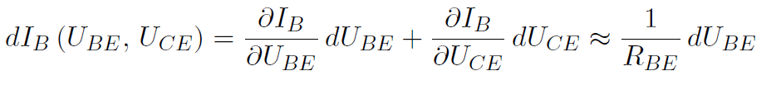
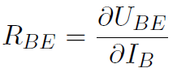
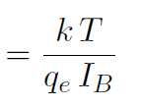
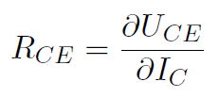
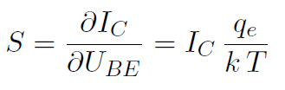

Transistor equations
There are several valid alternative views of transistor operation leading to other (related) equations.
differential base-emitter-resistance:
differential collector-emitter resistance:
Transconductance:

Slide 14

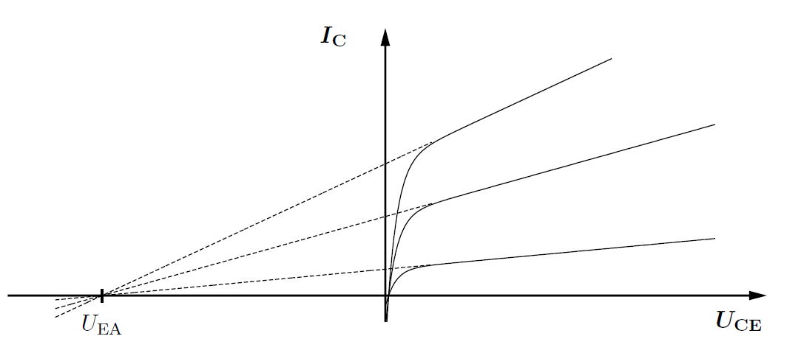
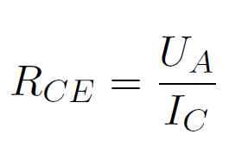
Early voltage
Extrapolating R_{CE} gives Early voltage U_{A} :
U_{A} ranges from 15 – 150 V.

Slide 15
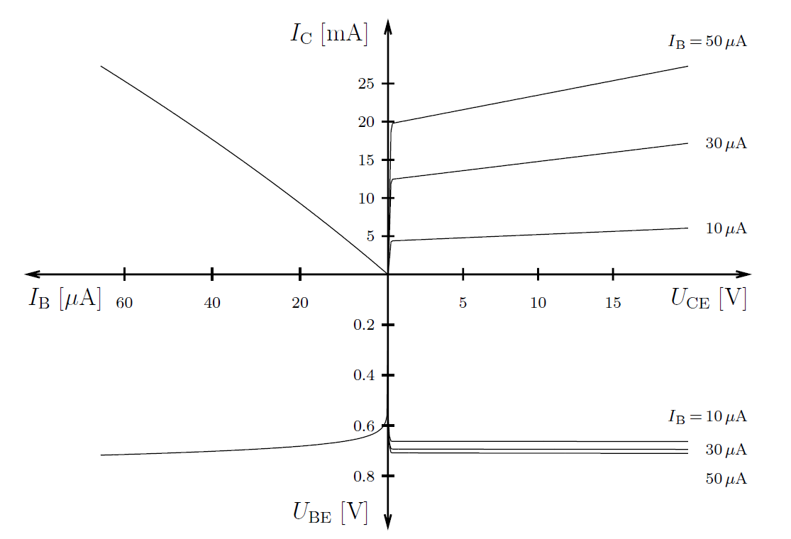
I-V curve overview
Discuss the curves in each part of the diagram.

Slide 16
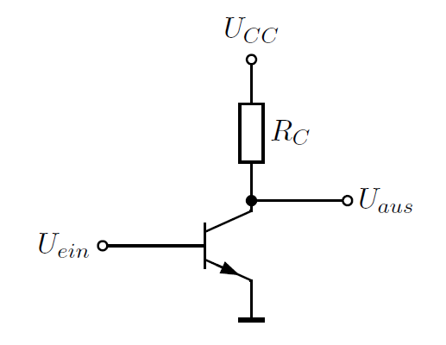




Common emitter amplifier
(This neglects R_{CE} and R_{C}.)
Output voltage is inverted.
Large R_{C} makes large voltage gain.
Large transconductance makes large gain. Recall

Slide 17
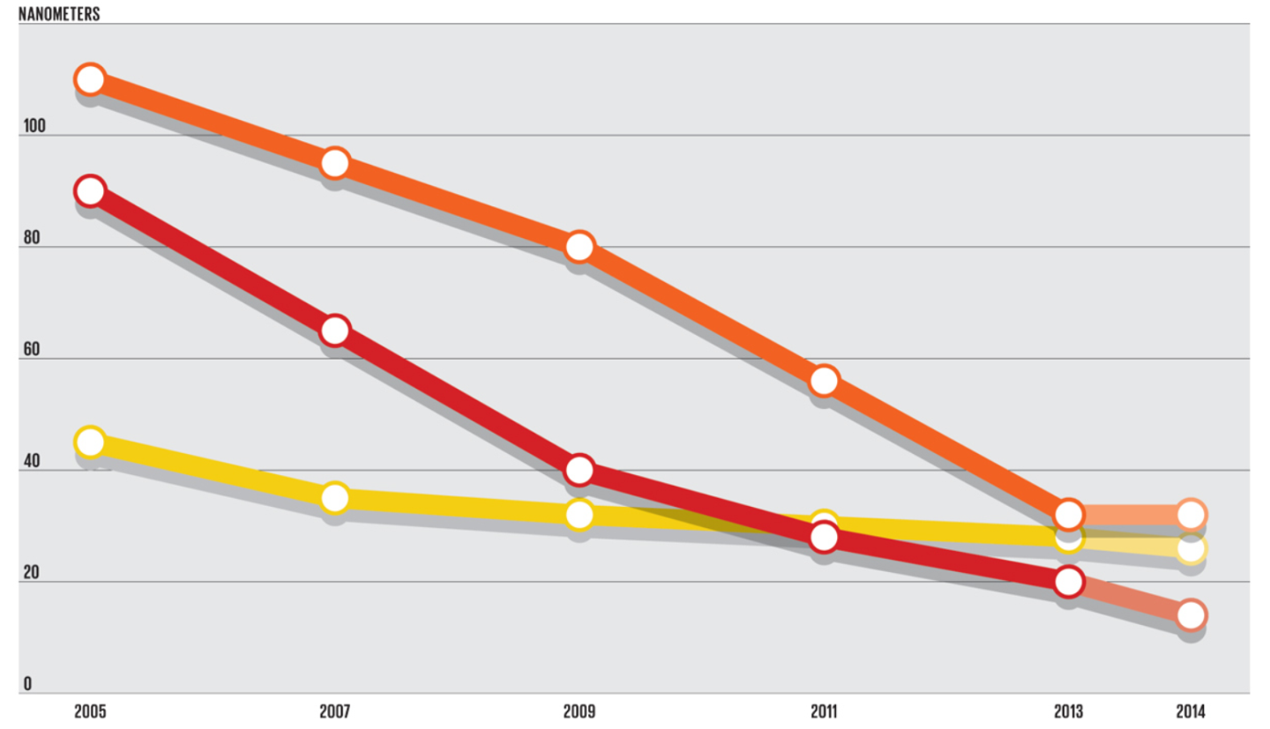
Moore‘s law
[nm]
Source: GlobalFoundries
100
80
60
40
20
0
metal 1/2 pitch
transistor gate length
node name
2005 2007 2009 2011 2013
Moore: geometrical dimensions of transistors have been shrinking.
Non-planar transistors are gaining traction since a decade or so.
Intel introduced FinFET in 2011 (22 nm process node).

Slide 18

Field-effect transistor topologies

Slide 19

Published in April 2011

Slide 20


Slide 21
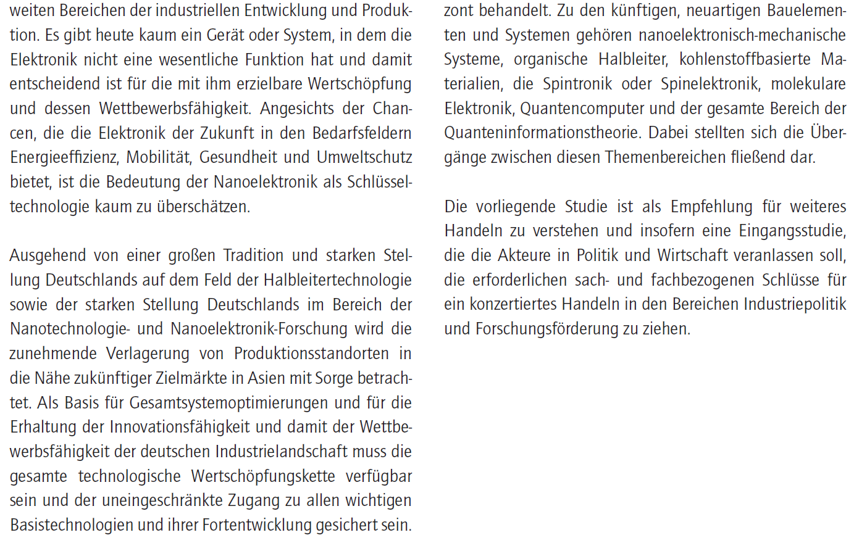

Slide 22
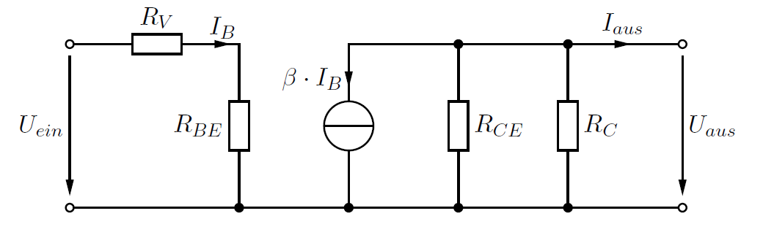
Small signal circuit analysis
Replace current and voltage sources by internal resistance
⇒ current source ≙ open circuit (infinite impedance)
voltage source ≙ short circuit (zero impedance)
Replace non-linear components by differential impedance at operation point.
Replace transistors by current- (or voltage-) driven current source.

Slide 23
Small signal analysis
⇒

Slide 24




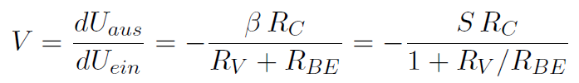

Example
R_{aus} =
and

Slide 25
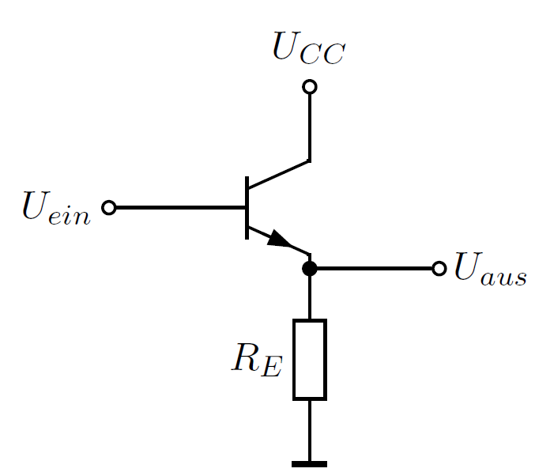
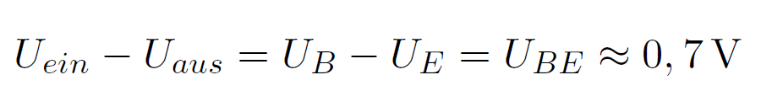
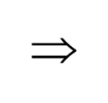
Emitter follower
with
and
Emitter follower drives current into load.
It does not amplify voltage.

Slide 26
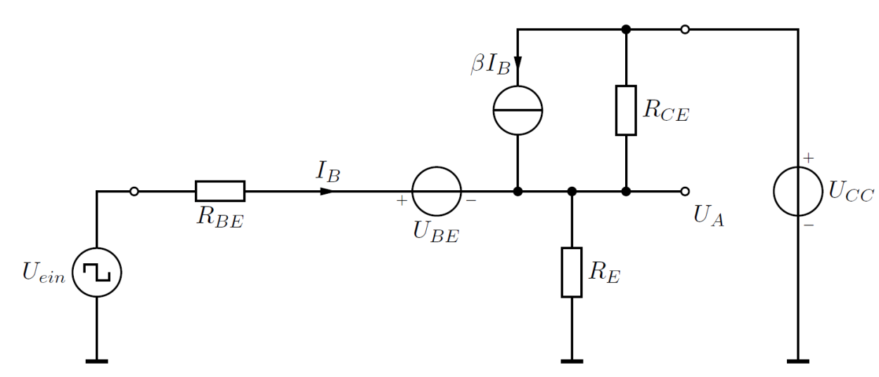
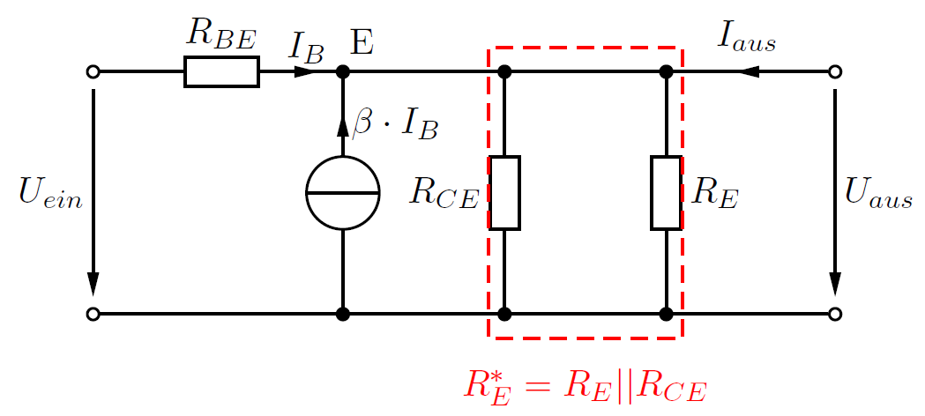

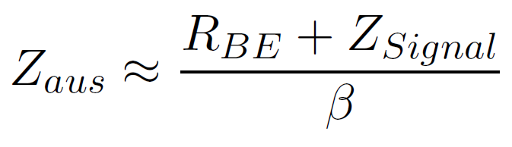
Emitter follower
Large-signal analysis:
Small signal analysis:

Slide 27
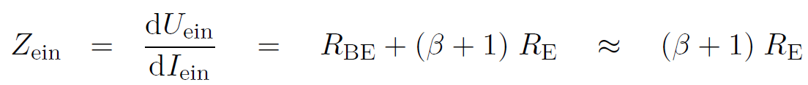
Emitter follower input impedance

Slide 28




Emitter follower output impedance
with
we get

Slide 29
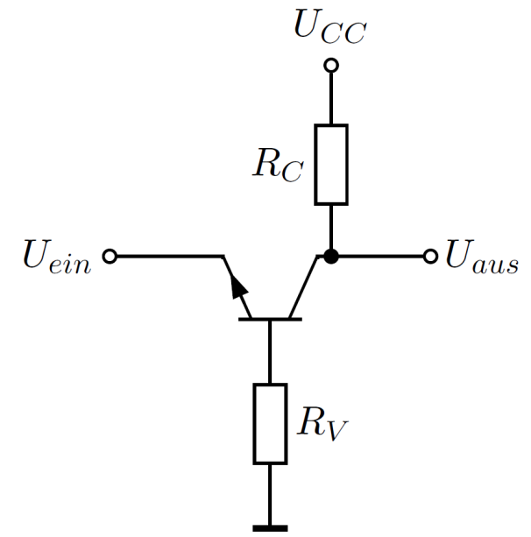

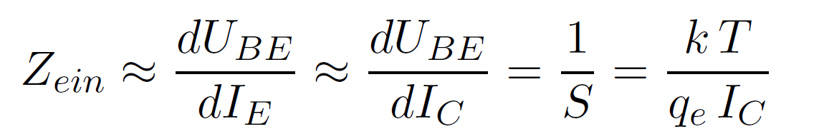
Common base amplifier
Similar to common emitter amplifier, but with low input impedance:
V_{U} = S R_{C}
V_{I} 1
Z_{aus} ~ R_{C}

Slide 30
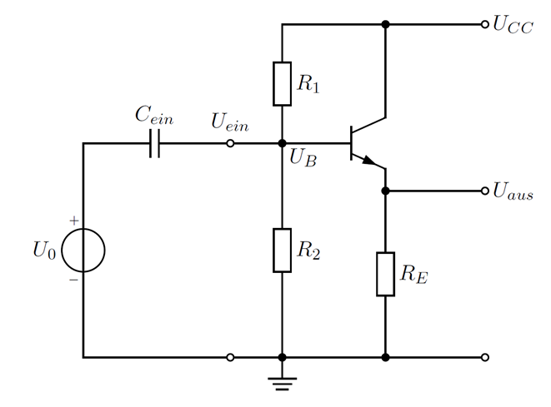
Operating point
So far we have neglected the amplifier bias.
Have to chose values for R₁, R₂, C_{ein} and R_{E} .
Choices depend on application.

Slide 31
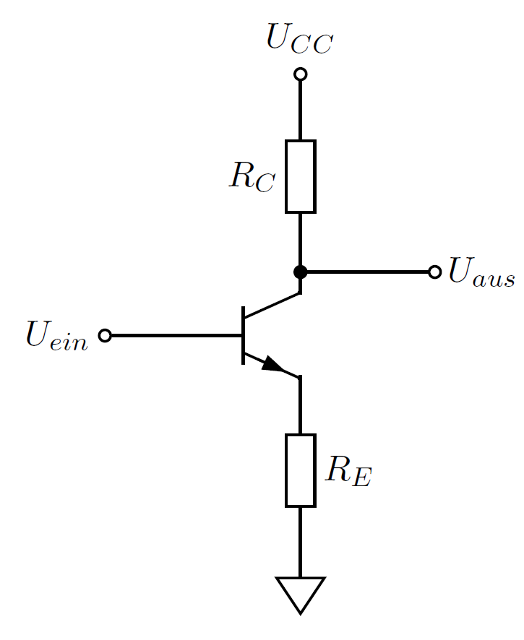
Common emitter amplifier with current feedback

Slide 32
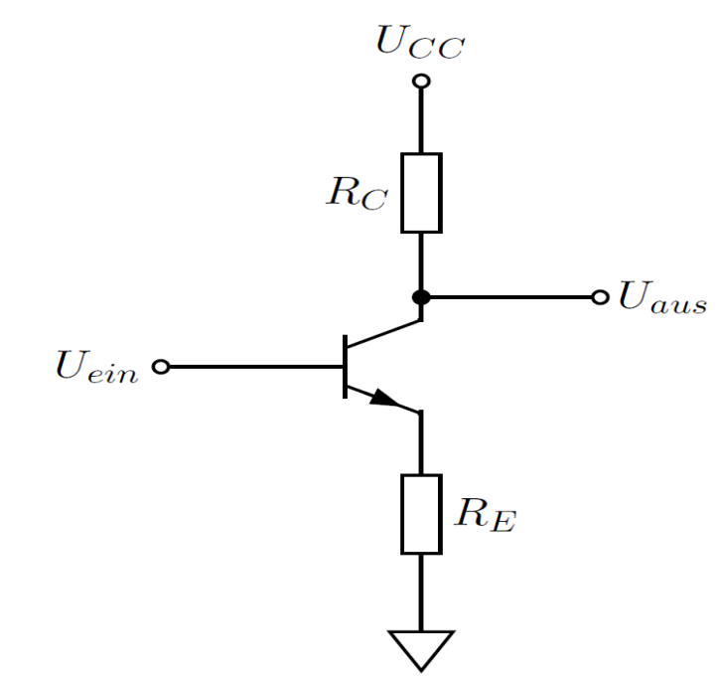
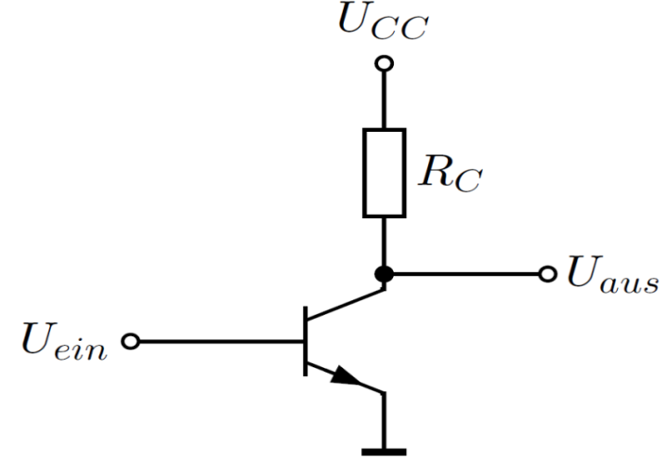
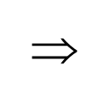
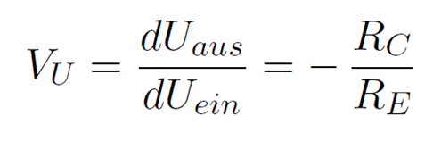
Common emitter amplifier with current feedback
No feedback
With feedback
with
Gain is independent of S !

Slide 33
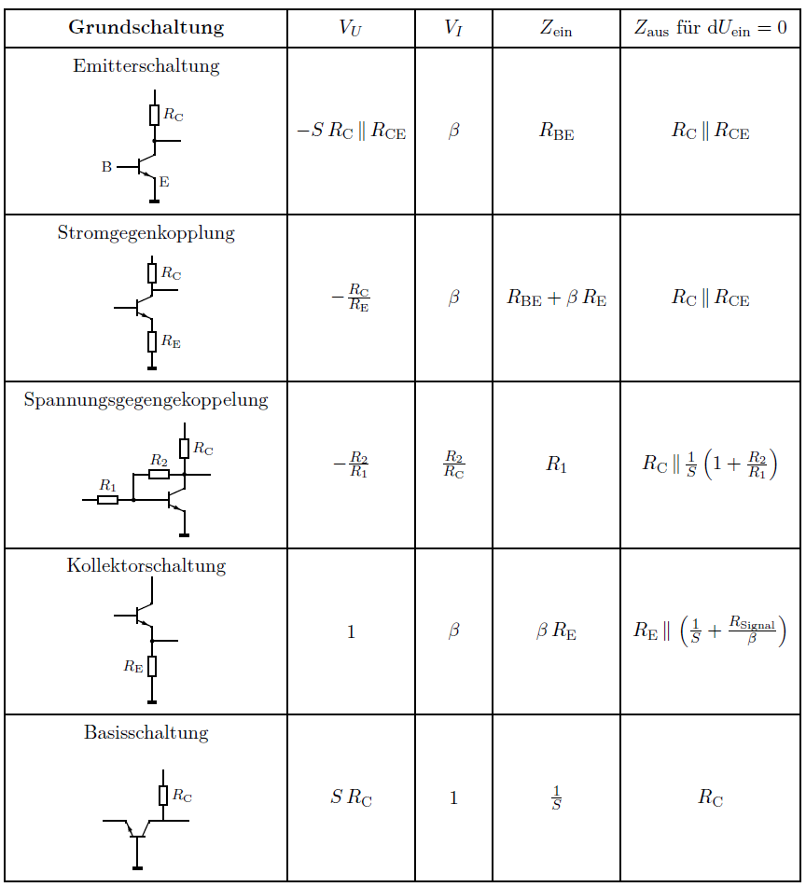
Overview of BJT circuits

Slide 34


Current source
R₁ and R₂ set U_{B} and thus I_{L}
U_{aus} can vary largely since I_{L} = I_{C} does not depend (much) on U_{CE}

Slide 35





Miller effect I
With
Input impedance is reduced
Input capacitance is much enhanced

Slide 36




Miller effect II
Capacitive feedback looks like large capacitance at input.
Thus, slow-down of op-amp

Slide 37

Input impedance
Z_{ein}= R_{E} (β + 1) (neglecting R_{L} and R_{CE})
Input impedance is given by R_{E} and β and is large. Why?
If R_{L} is large, R_{E} sets I_{C} and thus I_{B}. dU_{aus} = dU_{ein}
R_{E} effectively sets input impedance

Slide 38


Frequency dependence of amplifiers

Slide 39
Appendix

Slide 40


Output impedance
Output impedance is determined for current U_{EIN} considering circuit a
Thevenin equivalent voltage source with R_{IN} as output impedance
Z = $\frac{U no load}{I short}$

